Slide 1
Prediabetes
Comorbidities and Complications

Slide 2
Common Comorbidities of Prediabetes
Obesity
CVD
Dyslipidemia
Hypertension
Renal failure
Cancer
Sleep disorders
Handelsman YH, et al. Endocr Pract. 2015;21(suppl 1):1-87.

Slide 3
Clinical Risks of Not Treating Prediabetes Are Substantial
Microvascular disease
Retinopathy
Neuropathy
Nephropathy
Cardiovascular disease (CVD)
Heart disease
Stroke
Peripheral vascular disease
Zhang Y, et al. Population Health Management. 2009;12:157-163.
Garber AJ, et al. Endocr Pract. 2008;14:933-946.

Slide 4
The Spectrum of Cardiometabolic Disease
Genetic determinants
Prediabetic States
Metabolic syndrome*
IFG (FPG 100-126 mg/dL)
IGT (2-h OGTT 140-199 mg/dL)
A1C† 5.7%-6.4% (ADA) or 5.5%-6.4% (AACE)
Type 2 diabetes
Insulin resistance
Cardiovascular disease
Obesity
*2005 NCEP criteria.
†Diagnosis of prediabetes after positive A1C screening requires confirmation with FPG or OGTT measurement.
FPG, fasting plasma glucose; IFG, impaired fasting glucose; IGT, impaired glucose tolerance; OGTT, oral glucose tolerance test.
Grundy SM, et al. Circulation. 2005;112:2735-2752. Handelsman YH, et al. Endocr Pract. 2015;21(suppl 1):1-87.

Slide 5
obesity
Prediabetes Comorbidities and Complications

Slide 7
Older Obesity Pharmacotherapies
Agent | Phentermine | Diethylpropion
Mechanism | Central noradrenergic
Approval | Short-term use DEA Schedule II-IV
Cost | $
Common adverse effects | Restlessness Insomnia Increase in pulse Increase in blood pressure
DEA, Drug Enforcement Agency.
Diethylpropion Prescribing Information, 2007; Meridia Prescribing Information, 2010. Phentermine Prescribing Information, 2011; Xenical Prescribing Information, 2009.

Slide 8
Orlistat
Mechanism of Action
Indications
Reversible gastrointestinal lipase inhibitor
Weight loss and weight maintenance in conjunction with a reduced calorie diet
BMI ≥30 kg/m²
BMI ≥27 kg/m² with ≥1 weight-related comorbidity
Hypertension
T2D
Dyslipidemia
Dosing
120 mg thrice daily with each main meal containing fat, taken during or up to 1 hour after eating
See prescribing information for specific instructions
T2D = type 2 diabetes.
Xenical prescribing information. South San Francisco, CA: Genentech USA, Inc.; 2013.

Slide 9
Orlistat: Summary of Warnings and Contraindications
Contraindications
Warnings
Pregnancy
Chronic malabsorption syndrome
Cholestasis
Decreased cyclosporine exposure
Multivitamin supplement containing fat-soluble vitamins recommended to ensure adequate nutrition
Hepatocellular necrosis, acute hepatic failure
Increased urinary oxalate; monitor renal function
Cholelithiasis
Increased GI events with high-fat diets (fat >30% of total daily calories)
Adverse Effects
Oily spotting
Flatus with discharge
Fecal urgency and incontinence
Xenical prescribing information. South San Francisco, CA: Genentech USA, Inc.; 2013.

Slide 10
Orlistat : Clinical Efficacy
ITT Population, LOCF Analysis
Δ Weight (%)
P<0.001
P<0.001
ITT = intent to treat; LOCF = last observation carried forward; TID, three times daily.
Davidson MH, et al. JAMA. 1999;281:235-242.

Slide 11
Orlistat Adverse Events
Event occurring in ≥5% of patients and occurring at least twice as often with orlistat as placebo, % | Year 1 |  | Year 2
 | Orlistat 120 mg TID (N=1913) | Placebo (N=1466) | Orlistat 120 mg TID (N=613) | Placebo (N=524)
Oily spotting | 26.6 | 1.3 | 4.4 | 0.2
Flatus with discharge | 23.9 | 1.4 | 2.1 | 0.2
Fecal urgency | 22.1 | 6.7 | 2.8 | 1.7
Fatty/oily stool | 20.0 | 2.9 | 5.5 | 0.6
Oily evacuation | 11.9 | 0.8 | 2.3 | 0.2
Increased defecation | 10.8 | 4.1 | 2.6 | 0.8
Fecal incontinence | 7.7 | 0.9 | 1.8 | 0.2
TID = three times daily.
Xenical prescribing information. South San Francisco, CA: Genentech USA, Inc.; 2013.

Slide 12
Lorcaserin
Mechanism of Action
Indications
Specific 5-HT_{2C} (serotonin) receptor agonist
Adjunct to diet and exercise in patients with
BMI ≥30 kg/m²
BMI ≥27 kg/m² with ≥1 weight-related comorbidity
Hypertension
T2D
Dyslipidemia
Schedule IV Controlled Substance
Dosing
10 mg twice daily
Discontinue if 5% weight loss is not achieved within 12 weeks
See prescribing information for specific instructions
DEA, Drug Enforcement Agency; T2D, type 2 diabetes.
Belviq prescribing information. Woodcliff Lake, NJ: Eisai Inc.; 2012.

Slide 13
Lorcaserin: Summary of Warnings and Contraindications
Contraindications
Warnings
Pregnancy
Coadministration with other serotonergic or antidopaminergic agents has not been established
Valvular heart disease
Cognitive impairment
Psychiatric disorders: euphoria, dissociation, suicidal thoughts, depression
Priapism
Increased risk of hypoglycemia with antidiabetic medications
Adverse Effects
Headache
Dizziness
Nausea
Belviq prescribing information. Woodcliff Lake, NJ: Eisai Inc.; 2012.

Slide 14
Effect of Lorcaserin on Body Weight in Obese Adults Over 1 Year
BLOSSOM Study
Week
12
24
36
48
52
0
-2
-4
Δ LS mean weight (%)
-6
Placebo (n=1601)
Lorcaserin 10 mg BID (n=1602)
-8
BID, twice daily; LS, least squares.
Fidler MC, et al. J Clin Endocrinol Metab. 2011;96:3067-3077.

Slide 15
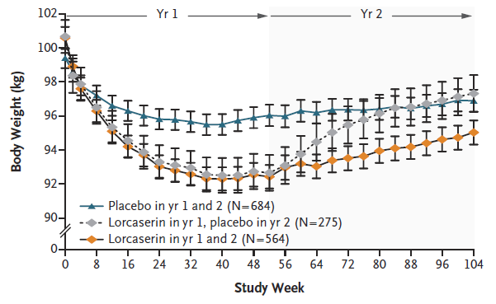
Effect of Lorcaserin on Body Weight in Obese Adults Over 2 Years
BLOOM Study
Smith SR, et al. N Engl J Med. 2010;363:245-256.

Slide 16
Effect of Lorcaserin on Cardiometabolic Risk Markers
BLOOM Study
Risk Factors (Mean % Weight Loss) | Lorcaserin 10 mg (5.8%) | P value*
Systolic BP, mmHg | ↓ -1.4 | 0.04
Diastolic BP, mmHg | ↓ -1.1 | 0.01
Triglycerides, % | ↓ -6.15 | <0.001
Total cholesterol, % | ↓ -0.90 | 0.001
LDL-C, % | ↑ 2.87 | 0.049
HDL-C, % | ↑ 0.05 | NS
hsCRP, mg/L | ↓ -1.19 | <0.001
Fibrinogen, mg/dL | ↓ -21.5 | 0.001
*P values represent comparisons to placebo.
Intent to treat, last observation carried forward analysis for total study population.
Smith SR, et al. N Engl J Med. 2010;363:245-256.

Slide 17
Effect of Lorcaserin on Hypertension
BLOSSOM Study
Blood Pressure
Antihypertensive Use
Placebo Lorcaserin 10 mg BID
BID, twice daily; LS, least squares.
Fidler MC, et al. J Clin Endocrinol Metab. 2011;96:3067-3077.

Slide 18
Effect of Lorcaserin on Dyslipidemia
BLOSSOM Study
Lipids
Lipid Medication Use
P<0.001
P<0.001
P=0.02
Placebo Lorcaserin 10 mg BID
BID, twice daily; LS, least squares.
Fidler MC, et al. J Clin Endocrinol Metab. 2011;96:3067-3077.

Slide 19
Lorcaserin Adverse Events
Event occurring in ≥5% of patients and more frequently than with placebo, % | Lorcaserin 10 mg BID (N=3195) | Placebo (N=3185)
Headache | 16.8 | 10.1
Upper respiratory tract infection | 13.7 | 12.3
Nasopharyngitis | 13.0 | 12.0
Dizziness | 8.5 | 3.8
Nausea | 8.3 | 5.3
Fatigue | 7.2 | 3.6
Urinary tract infection | 6.5 | 5.4
Diarrhea | 6.5 | 5.6
Back pain | 6.3 | 5.6
Constipation | 5.8 | 3.9
Dry mouth | 5.3 | 2.3
Belviq (lorcaserin HCl) prescribing information. Woodcliff Lake, NJ: Eisai Inc.; 2012.

Slide 20
Phentermine/Topiramate ER
Mechanism of Action
Dosing
Central noradrenergic effects
Phentermine: immediate-release sympathomimetic—affects appetite
Topiramate ER: delayed-release gabanergic—affects satiety
Once daily in morning
Starting dose: phentermine 3.75/topiramate ER 23 mg for 14 days
Usual dose: 7.5/46 mg
Maximum dose: 15/92 mg
If <3% weight loss after 12 weeks on usual dose, either discontinue medication or advance to maximum dose (transition dose phentermine 11.25 mg/topiramate ER 69 mg for 2 weeks)
If <5% weight loss after 12 weeks on maximum dose, then discontinue the medication (to discontinue take every other day for one week)
Indications
Adjunct to diet and exercise in patients with
BMI ≥30 kg/m²
BMI ≥27 kg/m² with ≥1 weight-related comorbidity
Hypertension
T2D
Dyslipidemia
See prescribing information for specific titration and discontinuation instructions
T2D, type 2 diabetes.
Qsymia prescribing information. Mountain View, CA: Vivus, Inc.; 2012.

Slide 21
Phentermine/Topiramate ER: Summary of Warnings and Contraindications
Contraindications
Warnings
Pregnancy
Glaucoma
Hyperthyroidism
Treatment with monoamine oxidase inhibitors (MAOIs)
Fetal toxicity
Increased heart rate
Suicide and mood and sleep disorders
Acute myopia and glaucoma
Metabolic acidosis
Creatinine elevations
Hypoglycemia with concomitant antidiabetic therapy
Adverse Effects
Dry mouth
Tingling
Constipation
Altered taste sensation
Upper respiratory infection
Qsymia prescribing information. Mountain View, CA: Vivus, Inc.; 2012.

Slide 22
Effect of Phentermine/Topiramate ER on Weight Loss in Obese Adults Over 1 Year
EQUIP Study: ITT-LOCF Analysis
Phen/TPM ER 15/92
(n=498)
Phen/TPM ER 3.75/23
(n=234)
Placebo
(n=498)
Δ Weight (%)
*
*
*P<0.0001 vs placebo.
ITT = intent to treat; LOCF = last observation carried forward; Phen/TPM ER = phentermine/topiramate extended release.
Allison DB, et al. Obesity (Silver Spring). 2012;20:330-342.

Slide 23
Effect of Phentermine/Topiramate ER on Weight Loss Over 2 Years
SEQUEL Study
(Completer Analysis)
Placebo Phen/TPM ER 7.5/46 Phen/TPM ER 15/92
0
CONQUER Trial
SEQUEL Extension
-2
-4
-6
-8
LS mean weight loss (%)
-10
-12
-14
-16
0
12
20
28
36
44
52
60
68
76
84
92
100
108
LOCF
Weeks
Placebo n: 227 227 227 208 197 227
Phen/TPM 7.5/46 n: 153 152 153 137 129 153
Phen/TPM 15/92 n: 295 295 295 268 248 295
Data are shown with mean (95% CI).
Phen/TPM ER, phentermine/topiramate extended release.
Garvey WT, et al. Am J Clin Nutr. 2012;95(2):297-308.

Slide 24
Effect of Phentermine/Topiramate ER on Cardiometabolic Risk Markers
CONQUER Study
Risk Factors (Mean % Weight Loss) | Phentermine/ Topiramate ER 7.5/46 mg (8.4%) | P value* | Phentermine/ Topiramate ER 15/92 mg (10.4%) | P value*
Systolic BP, mmHg | ↓ -4.7 | 0.0008 | ↓ -5.6 | <0.0001
Diastolic BP, mmHg | ↓ -3.4 | NS | ↓ -3.8 | 0.0031
Triglycerides, % | ↓ -8.6 | <0.0001 | ↓ -10.6 | <0.0001
Total cholesterol, % | ↓ -4.9 | 0.0345 | ↓ -6.3 | <0.0001
LDL-C, % | ↓ -3.7 | NS | ↓ -6.9 | 0.0069
HDL-C, % | ↑ 5.2 | <0.0001 | ↑ 6.8 | <0.0001
hsCRP, mg/L | ↓ -2.49 | <0.0001 | ↓ -2.49 | <0.0001
Adiponectin, μg/mL | ↑ 1.40 | <0.0001 | ↑ 2.08 | <0.0001
*P values represent comparisons to placebo.
Intent to treat, last observation carried forward analysis for total study population.
Gadde KM, et al. Lancet. 2011;377:1341-1352.

Slide 25
Effect of Phentermine/Topiramate ER on Hypertension
SEQUEL Study
Blood Pressure
Antihypertensive Use
Placebo Phen/TPM ER 7.5/46 mg Phen/TPM ER 15/92 mg
BP, blood pressure; Phen/TPM ER, phentermine/topiramate extended release; T2D, type 2 diabetes.
Garvey WT, et al. Am J Clin Nutr. 2012;95:297-308.

Slide 26
Effect of Phentermine/Topiramate ER on Dyslipidemia
SEQUEL Study
Lipids
Lipid Medication Use
*
*
*
*
*
Placebo Phen/TPM ER 7.5/46 mg Phen/TPM ER 15/92 mg
*P<0.01 vs placebo.
Phen/TPM ER, phentermine/topiramate extended release; T2D, type 2 diabetes.
Garvey WT, et al. Am J Clin Nutr. 2012;95:297-308.

Slide 27
Selected Phentermine/Topiramate ER Adverse Events
Event occurring in ≥5% of patients and more frequently than with placebo, % | Phentermine/Topiramate |  |  | Placebo (N=1561)
 | 3.75 mg/23 mg (N=240) | 7.5 mg/46 mg (N=498) | 15 mg/92 mg (N=1580)
Paresthesia | 4.2 | 13.7 | 19.9 | 1.9
Dry mouth | 6.7 | 13.5 | 19.1 | 2.8
Constipation | 7.9 | 15.1 | 16.1 | 6.1
Upper respiratory tract infection | 15.8 | 12.2 | 13.5 | 12.8
Headache | 10.4 | 7.0 | 10.6 | 9.3
Nasopharyngitis | 12.5 | 10.6 | 9.4 | 8.0
Dysgeusia | 1.3 | 7.4 | 9.4 | 1.1
Insomnia | 5.0 | 5.8 | 9.4 | 4.7
Dizziness | 2.9 | 7.2 | 8.6 | 3.4
Sinusitis | 7.5 | 6.8 | 7.8 | 6.3
Nausea | 5.8 | 3.6 | 7.2 | 4.4
Back pain | 5.4 | 5.6 | 6.6 | 5.1
Fatigue | 5.0 | 4.4 | 5.9 | 4.3
Diarrhea | 5.0 | 6.4 | 5.6 | 4.9
Bronchitis | 6.7 | 4.4 | 5.4 | 4.2
Vision blurred | 6.3 | 4.0 | 5.4 | 3.5
Urinary tract infection | 3.3 | 5.2 | 5.2 | 3.6
Influenza | 7.5 | 4.6 | 4.4 | 4.4
Qsymia prescribing information. Mountain View, CA: Vivus, Inc.; 2012.

Slide 28
Naltrexone/Bupropion SR
Mechanism of Action
Indications
Naltrexone: opioid receptor antagonist
Bupropion: norepinephrine-dopamine reuptake inhibitor
Adjunct to diet and exercise in patients with
BMI ≥30 kg/m²
BMI ≥27 kg/m² with ≥1 weight-related comorbidity
Hypertension
T2D
Dyslipidemia
Dosing
2 tablets twice a day
See prescribing information for specific instructions
T2D, type 2 diabetes.
Contrave prescribing information. Deerfield, IL: Takeda Pharmaceuticals America, Inc.; 2014.

Slide 29
Naltrexone/Bupropion SR: Summary of Warnings and Contraindications
Contraindications
Warnings
Uncontrolled hypertension
Seizures, anorexia, or discontinuation of alcohol, benzodiazepines, barbiturates, or antiepileptic drugs
Chronic opioid use
Use of other bupropion products or monoamine oxidase inhibitors
Suicidal behavior and ideation (black box warning)
Seizure
Increased blood pressure and heart rate
Hepatotoxicity
Angle-closure glaucoma
Adverse Effects
GI: nausea, vomiting, constipation, diarrhea
Headache, insomnia
Dry mouth
Contrave prescribing information. Deerfield, IL: Takeda Pharmaceuticals America, Inc.; 2014.

Slide 30
Effect of Naltrexone/Bupropion SR on Body Weight
COR II Study MITT-LOCF Analysis (N=1496)
P<0.001
P<0.001
COR II = CONTRAVE Obesity Research II; LOCF = last observation carried forward; MITT = modified intent to treat; SR = sustained release.
Apovian C, et al. Obesity (Silver Spring). 2013;21:935-943.

Slide 31
Effect of Naltrexone/Bupropion SR on Cardiometabolic Risk Markers
COR II Study
Risk Factors (Mean % Weight Loss) | Naltrexone/ Bupropion SR (6.4%) | P value*
Systolic BP, mmHg | ↑ 0.6 | 0.039
Diastolic BP, mmHg | ↑ 0.4 | NS
Triglycerides, % | ↓ -9.8 | <0.001
LDL-C, % | ↓ -6.2 | 0.008
HDL-C, % | ↑ 3.6 | <0.001
hsCRP, mg/L | ↓ -28.8 | <0.001
FBG, mg/dL | ↓ -2.8 | NS
*P value vs placebo.
BP, blood pressure; COR II, CONTRAVE Obesity Research II; FBG, fasting blood glucose; SR, sustained release.
Apovian C, et al. Obesity (Silver Spring). 2013;21:935-943.

Slide 32
Naltrexone/Bupropion SR Adverse Events
Event occurring in ≥5% of patients and more frequently than with placebo, % | Naltrexone/Bupropion SR 32 mg/360 mg (N=2545) | Placebo (N=1515)
Nausea | 32.5 | 6.7
Constipation | 19.2 | 7.2
Headache | 17.6 | 10.4
Vomiting | 10.7 | 2.9
Dizziness | 9.9 | 3.4
Insomnia | 9.2 | 5.9
Dry mouth | 8.1 | 2.3
Diarrhea | 7.1 | 5.2
Contrave prescribing information. Deerfield, IL: Takeda Pharmaceuticals America, Inc.; 2014.

Slide 33
Liraglutide (for Obesity)
Mechanism of Action
Indications
GLP-1 receptor agonist
Adjunct to diet and exercise in patients with
BMI ≥30 kg/m²
BMI ≥27 kg/m² with ≥1 weight-related comorbidity
Hypertension
T2D
Dyslipidemia
Dosing
3 mg once daily subcutaneous injection
See prescribing information for specific instructions
T2D, type 2 diabetes.
Saxenda prescribing information. Plainsboro, NJ: NovoNordisk Inc.

Slide 34
Liraglutide (for Obesity): Summary of Warnings and Contraindications
Contraindications
Warnings
Personal or family history of medullary thyroid carcinoma or multiple endocrine neoplasia syndrome type 2
Pregnancy
Thyroid tumors seen in rodent models
Acute pancreatitis or gallbladder disease
Hypoglycemia if used with sulfonylurea or glinide (in patients with T2D)
Heart rate increase
Renal impairment
Suicidal behavior or ideation
Do not use with insulin or to treat T2D
Adverse Effects
GI: nausea, diarrhea, constipation, vomiting, decreased appetite, dyspepsia, abdominal pain
Headache, fatigue
Dizziness
Increased lipase
T2D = type 2 diabetes.
Saxenda prescribing information. Plainsboro, NJ: NovoNordisk Inc.

Slide 35
Effects of Liraglutide in Obese Patients
SCALE Obesity
(N=3731)
Weight Change After 56 Weeks
Liraglutide
(n=2437)
Placebo
(n=1225)
Δ Weight (%)
P<0.001
Pi-Sunyer X, et al. N Engl J Med. 2015;373:11-22.

Slide 36
Effect of Liraglutide 3 mg on Cardiometabolic Risk Markers
SCALE Study
Risk Factors (Mean % Weight Loss) | Liraglutide 3 mg* (4.4%) | P value
Systolic BP, mmHg | ↓ -2.8 | <0.0001
Diastolic BP, mmHg | ↓ -0.6 | NS
Triglycerides, % | ↓ -6.0 | 0.0003
Total cholesterol, % | ↓ -2.0 | 0.03
LDL-C, % | ↓ -0.9 | NS
HDL-C, % | ↑ 0.9 | NS
VLDL-C, % | ↓ -6.0 | 0.0002
FFAs, % | ↓ -5.0 | 0.03
Waist circumference, cm | ↓ -3.5 | <0.0001
*Placebo-adjusted values; P values represent comparisons to placebo (ANCOVA).
Full analysis set of 3-year data.
Fujioka et al. ENDO 2016, 1–4 April 2016, Abstract 24365.

Slide 37
Liraglutide (for Obesity) Adverse Events
Event occurring in ≥5% of patients and more frequently than with placebo, % | Liraglutide 3 mg (N=3384) | Placebo (N=1941)
Nausea | 39.3 | 13.8
Headache | 13.6 | 12.6
Diarrhea | 20.9 | 9.9
Constipation | 19.4 | 8.5
Vomiting | 15.7 | 3.9
Decreased appetite | 10.0 | 2.3
Dyspepsia | 9.6 | 2.7
Dizziness | 6.9 | 5.0
Fatigue | 7.5 | 4.6
Abdominal pain | 5.4 | 3.1
Increased lipase | 5.3 | 2.2
Upper abdominal pain | 5.1 | 2.7
Saxenda prescribing information. Plainsboro, NJ: NovoNordisk Inc.

Slide 38
Effects of Different Types of Bariatric Surgery on Weight
Weight Loss as a Percentage of Excess Body Weight
Procedure | Follow-up Period (years)
 | 1-2 | 3-6 | 7-10
Vertical banded gastroplasty | 50-72 | 25-65 | --
Gastric banding | 29-87 | 45-72 | 14-60
Laparoscopic sleeve gastrectomy | 33-58 | 66 | 50-55
Roux-en-Y gastric bypass | 48-85 | 53-77 | 25-68
Banded Roux-en-Y gastric bypass | 73-80 | 66-78 | 60-70
Long-limb Roux-en-Y gastric bypass | 53-74 | 55-74 | --
Biliopancreatic diversion ± duodenal switch | 65-83 | 62-81 | 60-80
Mechanick JI, et al. Endocr Pract. 2008;14(suppl 1):1-83. Mechanick JI, et al. Endocr Pract. 2013;19:337-372.

Slide 39
Weight Loss with Different Bariatric Surgeries in Severely Obese Patients
Swedish Obese Subjects Study
(N=4047)
5
0
Control
Banding
Vertical banded gastroplasty
Gastric bypass
-5
-10
-15
Δ Mean Weight (%)
-20
-25
-30
-35
2
3
4
8
10
20
0
1
6
15
Years
No. patients
Control 2037 1490 1242 1267 556 176
Banding 376 333 284 284 150 50
Gastroplasty 1369 1086 987 1007 489 82
Bypass 265 209 184 180 37 13
BMI entry criteria: ≥34 kg/m² men, ≥38 kg/m² women.
Sjostrom L, et al. JAMA. 2012;307:56-65.

Slide 40
Bariatric Surgery Reduces Mortality in Severely Obese Patients
Swedish Obese Subjects Study
(N=4047)
Fatal CV Events
Total CV Events
Control (49 events)
Surgery (28 events)
HR, 0.56; 95% CI, 0.35-0.88; Log-rank P = 0.01
Control (49 events)
Surgery (28 events)
HR, 0.83; 95% CI, 0.69-1.00; Log-rank P = 0.05
0.035
0.16
0.030
0.14
0.025
0.12
0.020
0.10
Cumulative incidence
Cumulative incidence
0.08
0.015
0.06
0.010
0.04
0.005
0.02
0
0
0
6
12
18
0
6
12
18
Years
Years
No. at risk
Control 2037 1993 1423 405 2037 1945 1326 361
Surgery 2010 1970 1557 412 2010 1921 1468 375
BMI entry criteria: ≥34 kg/m² men, ≥38 kg/m² women.
Sjostrom L, et al. JAMA. 2012;307:56-65.

Slide 41
Weight Loss with Different Bariatric Surgeries in Obese Patients
ACS Bariatric Surgery Center Network Prospective Observational Study
(N=28,616)
Δ BMI (kg/m²)
*
*
*
*
*
*
*P<0.05 vs baseline.
ACS = American College of Surgeons; BL = baseline; BMI = body mass index; LAGB = laparoscopic adjustable gastric band; LSG = laparoscopic sleeve gastrectomy; RYGB = Roux-en-Y gastric bypass.
Hutter MM, et al. Ann Surg. 2011;254:410-420.

Slide 42
Effect of Different Bariatric Surgeries on Weight-Related Comorbidities at 1 Year
ACS Bariatric Surgery Center Network Prospective Observational Study
(N=28,616)
†
†
‡
‡
Patients with resolution or improvement of condition (%)
‡
*Small numbers of patients with 1 year of follow-up for all comorbidities (n≤38).
†P<0.05 vs LAGB; ‡P<0.05 vs LRYGB.
ACS, American College of Surgeons; BMI, body mass index; GERD, gastroesophageal reflux disease; LAGB, laparoscopic adjustable gastric band; LSG, laparoscopic sleeve gastrectomy; LRYGB, laparoscopic Roux-en-Y gastric bypass.
Hutter MM, et al. Ann Surg. 2011;254:410-420.

Slide 43
Microvascular complications
Prediabetes Comorbidities and Complications

Slide 44
Impaired Fasting Glucose and Correlations With Diabetes, Hypertension, and Retinopathy
Population-Based Cross-sectional Studies
Patients (%)
Blue Mountains Eye Study (BMES) (N=3654, 99% white) FPG=95.4 mg/dL
Australian Diabetes, Obesity and Lifestyle Study (AusDiab) (N=2773; ~95% white) FPG=117 mg/dL
Multi-ethnic Study of Atherosclerosis (MESA) (N=6237; 40% white, 27% black, 22% Hispanic, 12% Chinese)
FPG=106 mg/dL
Hypertension defined as >140/90 mm Hg.
Wong TY, et al. Lancet. 2008;371:736-743.

Slide 45
FPG Thresholds Above Which Retinopathy Prevalence Rises
 | Blue Mountains Eye Study | Australian Diabetes, Obesity, and Lifestyle Study | Multi-ethnic Study of Atherosclerosis
On visual inspection | 6.3-7.0 mmol/l (113-126 mg/dL) | 7.1-7.8 mmol/l (128-140 mg/dL) | No clear threshold
Change point model | 5.2 mmol/l (94 mg/dL) | 6.3 mmol/l (113 mg/dL) | No clear threshold
FPG, fasting plasma glucose.
Wong TY, et al. Lancet. 2008;371:736-743.

Slide 46
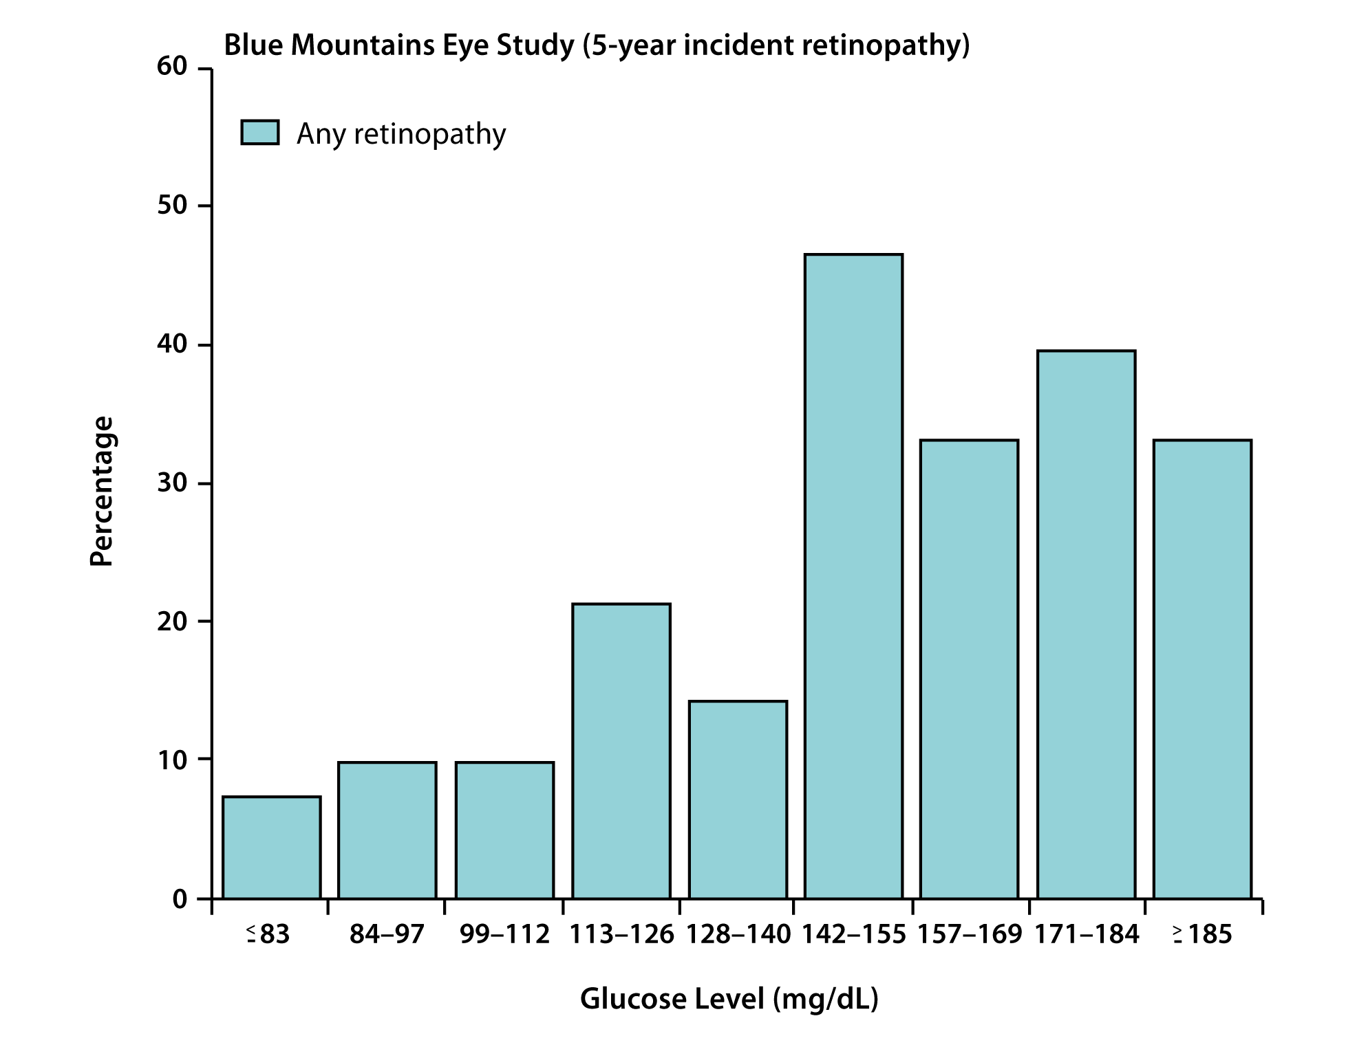
Relationship Between FPG and 5-Year Incident Retinopathy
FPG, fasting plasma glucose.
Wong TY, et al. Lancet. 2008;371:736-743.

Slide 47
Association of Retinopathy and Albuminuria With Glycemia
The prevalence of retinopathy rises dramatically with increasing deciles of glycemia; for microalbuminuria, the increase in prevalence was more gradual
FPG values corresponded well with WHO diagnostic cut points for diabetes while the 2-hour PG value did not
A1C thresholds were similar for both retinopathy and microalbuminuria
FPG, fasting plasma glucose; PG, plasma glucose; WHO, World Health Organization.
Tapp RJ, et al. Diabetes Res Clin Pract. 2006;73:315-321.

Slide 48
Diabetic Retinopathy in the DPP
Nondiabetic retinopathy ETDRS levels 14-15
Percent
12.6†
Diabetic retinopathy ETDRS levels 20-43
7.9
*Mild/moderate NPDR: microaneurysms plus ≥1 of the following: venous loops >0/1; soft exudates, intraretinal microvascular abnormalities or venous beading; retinal hemorrhages; hard exudates >0/1; or soft exudates >0/1.
†P=0.035 vs nondiabetic.
DPP, Diabetes Prevention Program; ETDRS, Early Treatment of Diabetic Retinopathy Study; IRMA, intraretinal microvascular abnormalities; NPDR, nonproliferative diabetic retinopathy.
DPP Research Group. Diabet Med.. 2007;24:137-144.

Slide 49
Prevalence of CKD in US Adults With Undiagnosed T2D or Prediabetes
NHANES 1999-2006
(N=8188)
41.7
Population (%)
17.7
10.6
Estimation of GFR by the MDRD Study equation, by diabetes status. Undiagnosed diabetes defined as FPG ≥126 mg/dL, without a report of provider diagnosis; prediabetes is defined as FPG ≥100 and <126 mg/dL; and no diabetes is defined as FPG <100 mg/dL.
*Plus a single measurement of albuminuria.
CKD, chronic kidney disease; FPG, fasting plasma glucose; GFR, glomerular filtration rate; MDRD, modification of diet in renal disease; NHANES = National Health and Nutrition Examination Survey; T2D, type 2 diabetes.
Plantinga LC, et al. Clin J Am Soc Nephrol. 2010;5:673-682.

Slide 50
Prevalence of Diabetic Nephropathy in Prediabetes and T2D
Diabetes Prevention Program
Baseline
(N=3188)
End of Study
(N=2802)
Patients With ACR ≥30 mg/g (%)
ACR, albumin to creatinine ratio; DPP, Diabetes Prevention Program; T2D, type 2 diabetes.
DPP Research Group. Diabetes Care. 2009;32:720-725.

Slide 51
Diabetic Nephropathy in Prediabetes
Diabetes Prevention Program
End of Study Status | Placebo (n=940) | Metformin (n=931) | Intensive Lifestyle Intervention (n=931)
Stable status | 883 (93.9%) | 861 (92.5%) | 863 (92.7%)
Worsened albuminuria | 33 (3.5%) | 35 (3.8%) | 28 (3.0%)
Improved albuminuria | 24 (2.6%) | 35 (3.8%) | 40 (4.3%)
Net increase in elevated ACR | 9 (1.0%) | 0 (0.0%) | -12 (-1.3%)
ACR, albumin to creatinine ratio; DPP, Diabetes Prevention Program.
DPP. Diabetes Care. 2009;32:720-725.

Slide 52
Impact of TZD Therapy on Nephropathy in Prediabetes
DREAM Trial
(N=5269)
Event | Rosiglitazone | Placebo | HR (95% CI)
Normal → microalbuminuria | 241 (9.2%) | 285 (10.8%) | 0.83 (0.69-0.99)
Microalbuminuria → proteinuria | 6 (0.23%) | 13 (0.49%) | 0.46 (0.18-1.21)
↓ eGFR ≥ 30% | 82 (3.1%) | 105 (4.0%) | 0.77 (0.58-1.04)
Microalbuminuria → normal | 193 (52.5%) | 185 (48.7%) | 1.18 (0.88-1.57)
Cl, confidence interval; DREAM, Diabetes Reduction Assessment with Ramipril and Rosiglitazone Medication; eGFR, estimated glomerular filtration rate; HR, hazard ratio; TZD, thiazolidinedione.
DREAM Investigators. Diabetes Care. 2008;31:1007-1014.

Slide 53
Metabolic syndrome
Prediabetes Comorbidities and Complications

Slide 54
Syndrome X (1988): A Historical Review
Metabolic disturbances commonly cluster in patients with cardiovascular disease, even without diabetes
Characteristics | Resistance to insulin-stimulated glucose uptake Hyperinsulinemia Hypertension Glucose intolerance Increased triglycerides and VLDL Decreased HDL-C
Other observations | Resistance to insulin-stimulated suppression of adipose tissue lipolysis increases free fatty acids Obesity was not a required trait, but Syndrome X was more common in overweight or obese individuals
HDL-C, high-density lipoprotein cholesterol; VLDL, very low-density lipoprotein.
Reaven GM. Diabetes. 1988;37:1595-1607.

Slide 55
Clinical Identification of the Metabolic Syndrome
Risk Factor* | Defining Level
 | ATP III (2002) | AHA/ACC (2005)
Abdominal obesity Men | ≥102 cm (≥40 in) | ≥102 cm (≥40 in)
Women | ≥88 cm (≥35 in) | ≥88 cm (≥35 in)
Triglycerides | ≥150 mg/dL | ≥150 mg/dL
HDL-C Men | <40 mg/dL | <40 mg/dL
Women | <50 mg/dL | <50 mg/dL
Blood pressure Systolic | ≥130 mmHg | ≥130 mmHg
Diastolic | ≥85 mmHg | ≥85 mmHg
Fasting glucose | ≥110 mg/dL | ≥100 mg/dL
*≥3 criteria must be met for diagnosis.
ACC, American College of Cardiology; AHA, American Heart Association; ATP III, National Cholesterol Education Program Adult Treatment Panel III; HDL-C, high-density lipoprotein cholesterol; TC, total cholesterol; TG, triglyceride.
Grundy SM, et al. Circulation. 2005;112:2735-2752. NCEP. Circulation. 2002;106:3143-3421.

Slide 56
Abdominal Obesity and Increased Risk of Cardiovascular Events
The HOPE Study
Waist Circumference (cm)
Men Women
Tertile 1 <95 <87
Tertile 2 95-103 87-98
Tertile 3 >103 >98
Relative risk*
*Adjusted for BMI, age, smoking, sex, CVD disease, DM, HDL cholesterol, total cholesterol.
BMI, body mass index; CVD, cardiovascular disease; DM, diabetes mellitus; HDL, high-density lipoprotein cholesterol;
MI, myocardial infarction.
Dagenais GR, et al. Am Heart J. 2005;149:54-60.

Slide 57
Incidence of Diabetes by Waist Circumference and Race/Ethnicity
The Multi-Ethnic Study of Atherosclerosis (2000–2007)
8.00
Chinese
Hispanic
7.00
6.00
Black
5.00
Incidence of Diabetes
Per 100 Person-Years
White
4.00
3.00
2.00
1.00
0.00
70
80
90
100
110
120
130
Waist Circumference (cm)
Solid lines pertain to values between the race-specific 5th and 95th percentiles of waist circumference. Dotted lines are extrapolated values outside the aforementioned race-specific ranges. Adjusted for age, sex, education, and income.
Lutsey PL, et al. Am J Epidemiol. 2010;172:197-204.

Slide 58
Roughly One-Third of Obese Individuals Are Metabolically Healthy
NHANES 1999-2004
Men
Women
Metabolically healthy Metabolically abnormal
*
*
*
*
Population (%)
*P<0.001 vs metabolically abnormal, normal weight.
NHANES, National Health and Nutrition Examination Survey.
Wildman RP, et al. Arch Intern Med. 2008;168:1617-1624.

Slide 59
Characteristics of Metabolically Healthy vs Insulin Resistant Obese
NS
P<0.05
Kilograms
Kilograms
P<0.05
P<0.05
Absolute units
Percentage
BMI (kg/m²)
BMI (kg/m²)
BMI, body mass index; IR, insulin resistant; IS, insulin sensitive.
Stefan N, et al. Arch Int Med. 2008;168:1609-1616.

Slide 60
Metabolic Syndrome vs Obesity in Cardiovascular Risk
Women's Ischemia Syndrome Evaluation (WISE) Study
BMI Status
Metabolic Status
N
1
Obese Normal 77
Overweight Normal 120
0.95
Normal Normal 132
Obese Dysmetabolic 250
Proportion of Patients Free From MACE
Overweight Dysmetabolic 149
0.9
Normal Dysmetabolic 52
0.85
0.8
1 Year
2 Year
3 Year
BMI, body mass index; MACE, major adverse cardiac event (death, nonfatal myocardial infarction, stroke, congestive heart failure).
Kip KE et al. Circulation. 2004;109:706-713.

Slide 61
Metabolic Markers of CV Risk in Overweight, Insulin-Resistant Individuals
ROC Curve Analysis
1.00
TG-HDL ratio
TG
Insulin
TC-HDL ratio
BMI
HDL
Glucose
TC
0.75
Sensitivity (true-positive)
0.50
0.25
Point of CV Risk Increase
TG | ≥130 mg/dL
TB-HDL ratio | ≥3.0
Insulin | ≥109 pmol/L
0.00
0
0.25
0.50
0.75
1.00
Specificity (false-positive)
TG, TG-HDL ratio, and insulin most useful metabolic markers for insulin resistance
BMI, body mass index; HDL, high-density lipoprotein; ROC, receiver-operating characteristic; TC, total cholesterol; TG, triglyceride.
McLaughlin T, et al. Ann Intern Med. 2003;139:802-809.

Slide 62
Metabolic Syndrome and Risk of Incident Cardiovascular Events and Death
Systematic Review and Meta-analysis*
(37 Longitudinal Studies; N=172,573)
Outcome
CV event
CHD event
CV death
CHD death
Death
Studies (N)
11
18
10
7
12
RR
2.18
1.65
1.91
1.60
1.60
95% CI
1.63-2.93
1.37-1.99
1.47-2.49
1.28-2.01
1.37-1.92
0.5 1 2 5
Decreased risk Increased risk
*Timespan: 1971 to 1997; metabolic syndrome defined using NCEP, WHO, or modified criteria.
CHD, coronary heart disease; CI, confidence interval; CV, cardiovascular; NCEP, National Cholesterol Education Program; RR, relative risk; WHO, World Heath Organization.
Gami AS, et al. J Am Coll Cardiol. 2007;49:403-414.

Slide 63
Overlap Between Metabolic Syndrome and Hyperglycemia
NHANES 1988-1994
Participants Age ≥50 Years
IFG or diabetes
20.6%
Both
61.0%
Metabolic syndrome
18.4%
IFG, impaired fasting glucose; NHANES, National Health and Nutrition Examination Survey.
Alexander CM, et al. Am J Cardiol. 2006;98:982-985.

Slide 64
Risk of Developing Type 2 Diabetes
San Antonio Heart Study
Age- and Sex-Adjusted Incidence of Diabetes
P<0.0001
P<0.0001
Diabetes Risk (%)
P=0.0018
Met Syn
MS+
No Met Syn
MS-
IGT, impaired glucose tolerance (2-h post-load glucose ≥140 mg/dL); Met Syn, metabolic syndrome as defined in ATP III.
Lorenzi C, et al. Diabetes Care. 2003;26:3153-3159.

Slide 65
Macrovascular complications
Prediabetes Comorbidities and Complications

Slide 66
Baseline Proteinuria Increases Cardiovascular Risk
Systematic Review
(RCTs: N=29; Patients with DM: N=116,790; ~518,611 patient-years of follow-up)
~6-fold higher
~15-fold higher
~13-fold higher
~12-fold higher
CVD, cardiovascular disease; MI, myocardial infarction.
Preiss D, et al. Am Heart J. 2011;161:210-219.

Slide 67
Risk of All-Cause and CV Mortality According to eGFR and Albuminuria
CV, cerebrovascular; eGFR, estimated glomerular filtration rate; HR, hazard ratio.
Chronic Kidney Disease Prognosis Consortium. Lancet. 2010;375:2073-2081 .

Slide 68
AACE ASCVD Risk Categories
Low risk: No risk factors | Extreme risk: Progressive ASCVD, including unstable angina that persists after achieving an LDL-C less than 70 mg/dL, or established clinical ASCVD with diabetes, stage 3 or 4 CKD, and/or HeFH, or in those with a history of premature ASCVD (<55 years of age for males or <65 years of age for females) This category was added in this CPG based on clinical trial evidence and supported by meta-analyses that further lowering of LDL-C produces better outcomes in individuals with ACS. IMPROVE-IT demonstrated lower rates of cardiovascular events in those with ACS when LDL-C levels were lowered to 53 mg/dL combining ezetimibe with statins.
Moderate risk: 2 or fewer risk factors and a calculated 10-year risk of less than 10%
High risk: An ASCVD equivalent including diabetes or stage 3 or 4 CKD with no other risk factors, or individuals with 2 or more risk factors and a 10-year risk of 10%-20%
Very high risk: Established or recent hospitalization for ACS; coronary, carotid or peripheral vascular disease; diabetes or stage 3 or 4 CKD with 1 or more risk factors; a calculated 10-year risk greater than 20%; or HeFH
ACS, acute coronary syndrome; ASCVD, atherosclerotic cardiovascular disease; CKD, chronic kidney disease; CPG, clinical practice guideline; HeFH, heterozygous familial hypercholesterolemia; LDL-C, low-density lipoprotein cholesterol; IMPROVE-IT, Improved Reduction of Outcomes: Vytorin Efficacy International Trial.
Jellinger PS, et al. Endocr Pract. 2017;23(suppl 2):1-87. Cannon, CP, et al. N Engl J Med. 2015;372(25):2387-239.

Slide 70
Elevated Risk of CVD Prior to Clinical Diagnosis of Type 2 Diabetes
Nurses Health Study*
(N=117,629)
Relative risk
Nondiabetic
throughout the
study
Prior to diagnosis
of diabetes
After diagnosis
of diabetes
Diabetic at
baseline
*Female nurses with no CVD at baseline aged 30-55 years and followed from 1976 to 1996.
CVD, cardiovascular disease.
Hu FB, et al. Diabetes Care. 2002;25:1129-1134.

Slide 71
Glucose Levels and Mortality in Individuals Without Known Diabetes
The DECODE Study
2.50
2.00
1.50
Hazard ratio for death*
1.00
≥ 200
0.50
2-h glucose (mg/dL)
140-199
0.00
<140
<110
110-125
126-139
≥140
Fasting glucose (mg/dL)
Postprandial glucose is an independent risk factor predicting mortality
*Adjusted for age, sex, and study center.
DECODE, Diabetes Epidemiology: Collaborative Analysis of Diagnostic Criteria in Europe.
DECODE Study Group. Lancet. 1999;354:617-621.

Slide 72
Effect of Metformin and Lifestyle Change on Blood Pressure
Diabetes Prevention Program
(N=3234)
Blood Pressure Change
Hypertension Prevalence
*
*
*
P<0.001
*P<0.001 vs placebo and metformin.
DPP, Diabetes Prevention Program.
Ratner R, et al. Diabetes Care. 2005;28:888-894.

Slide 73
Incidence of Hypertension in Patients with IGT
STOP NIDDM
(N=1429)
Hypertension defined as blood pressure ≥140/90 mmHg.
IGT, impaired glucose tolerance; STOP NIDDM, Study to Prevent Non-Insulin Dependent Diabetes Mellitus.
Chiasson JL, et al. JAMA. 2003;290:486-494.

Slide 74
CVD Outcomes in Type 2 Diabetes Prevention Trials
Study | Outcome
DPP | 64 of 3234 patients (89 total events)
DREAM | 0.5 events/100 patient-years
STOP NIDDM | 1.4 events/100 patient-years
CVD, cardiovascular disease; DPP, Diabetes Prevention Program; DREAM, Diabetes Reduction Assessment with Ramipril and Rosiglitazone Medication; STOP NIDDM, Study to Prevent Non-Insulin Dependent Diabetes Mellitus.
Ratner R, et al. Diabetes Care. 2005;28:888-894. DREAM Investigators. Diabetes Care. 2008;31:1007-1014. Chiasson JL, et al. JAMA. 2003;290:486-494.

Slide 75
Effect of Acarbose on Cardiovascular Events in Patients With IGT
STOP NIDDM
(N=1429)
CVD, cardiovascular disease; IGT, impaired glucose tolerance; RRR, relative risk reduction; STOP NIDDM, Study to Prevent Non-Insulin Dependent Diabetes Mellitus Trial.
Chiasson JL, et al. JAMA. 2003;290:486-494.

Slide 76
Effect of Acarbose on CVD Events in IGT
STOP NIDDM
(N=1429)
 | Acarbose (N=682) | Placebo (N=686) | Hazard Ratio
Myocardial infarction | 1 | 12 | 0.09*
Angina | 5 | 12 | 0.45
Revascularization | 11 | 20 | 0.61
CVD death | 1 | 2 | 0.55
Cerebrovascular event or stroke | 2 | 4 | 0.56
Peripheral vascular disease | 1 | 1 | 1.14
Any CVD event | 15 | 32 | 0.51*
*P<0.05
CVD, cardiovascular disease; IGT, impaired glucose tolerance; STOP NIDDM, Study to Prevent Non-Insulin Dependent Diabetes.
Chiasson JL, et al. JAMA. 2003;290:486-494.

Slide 77
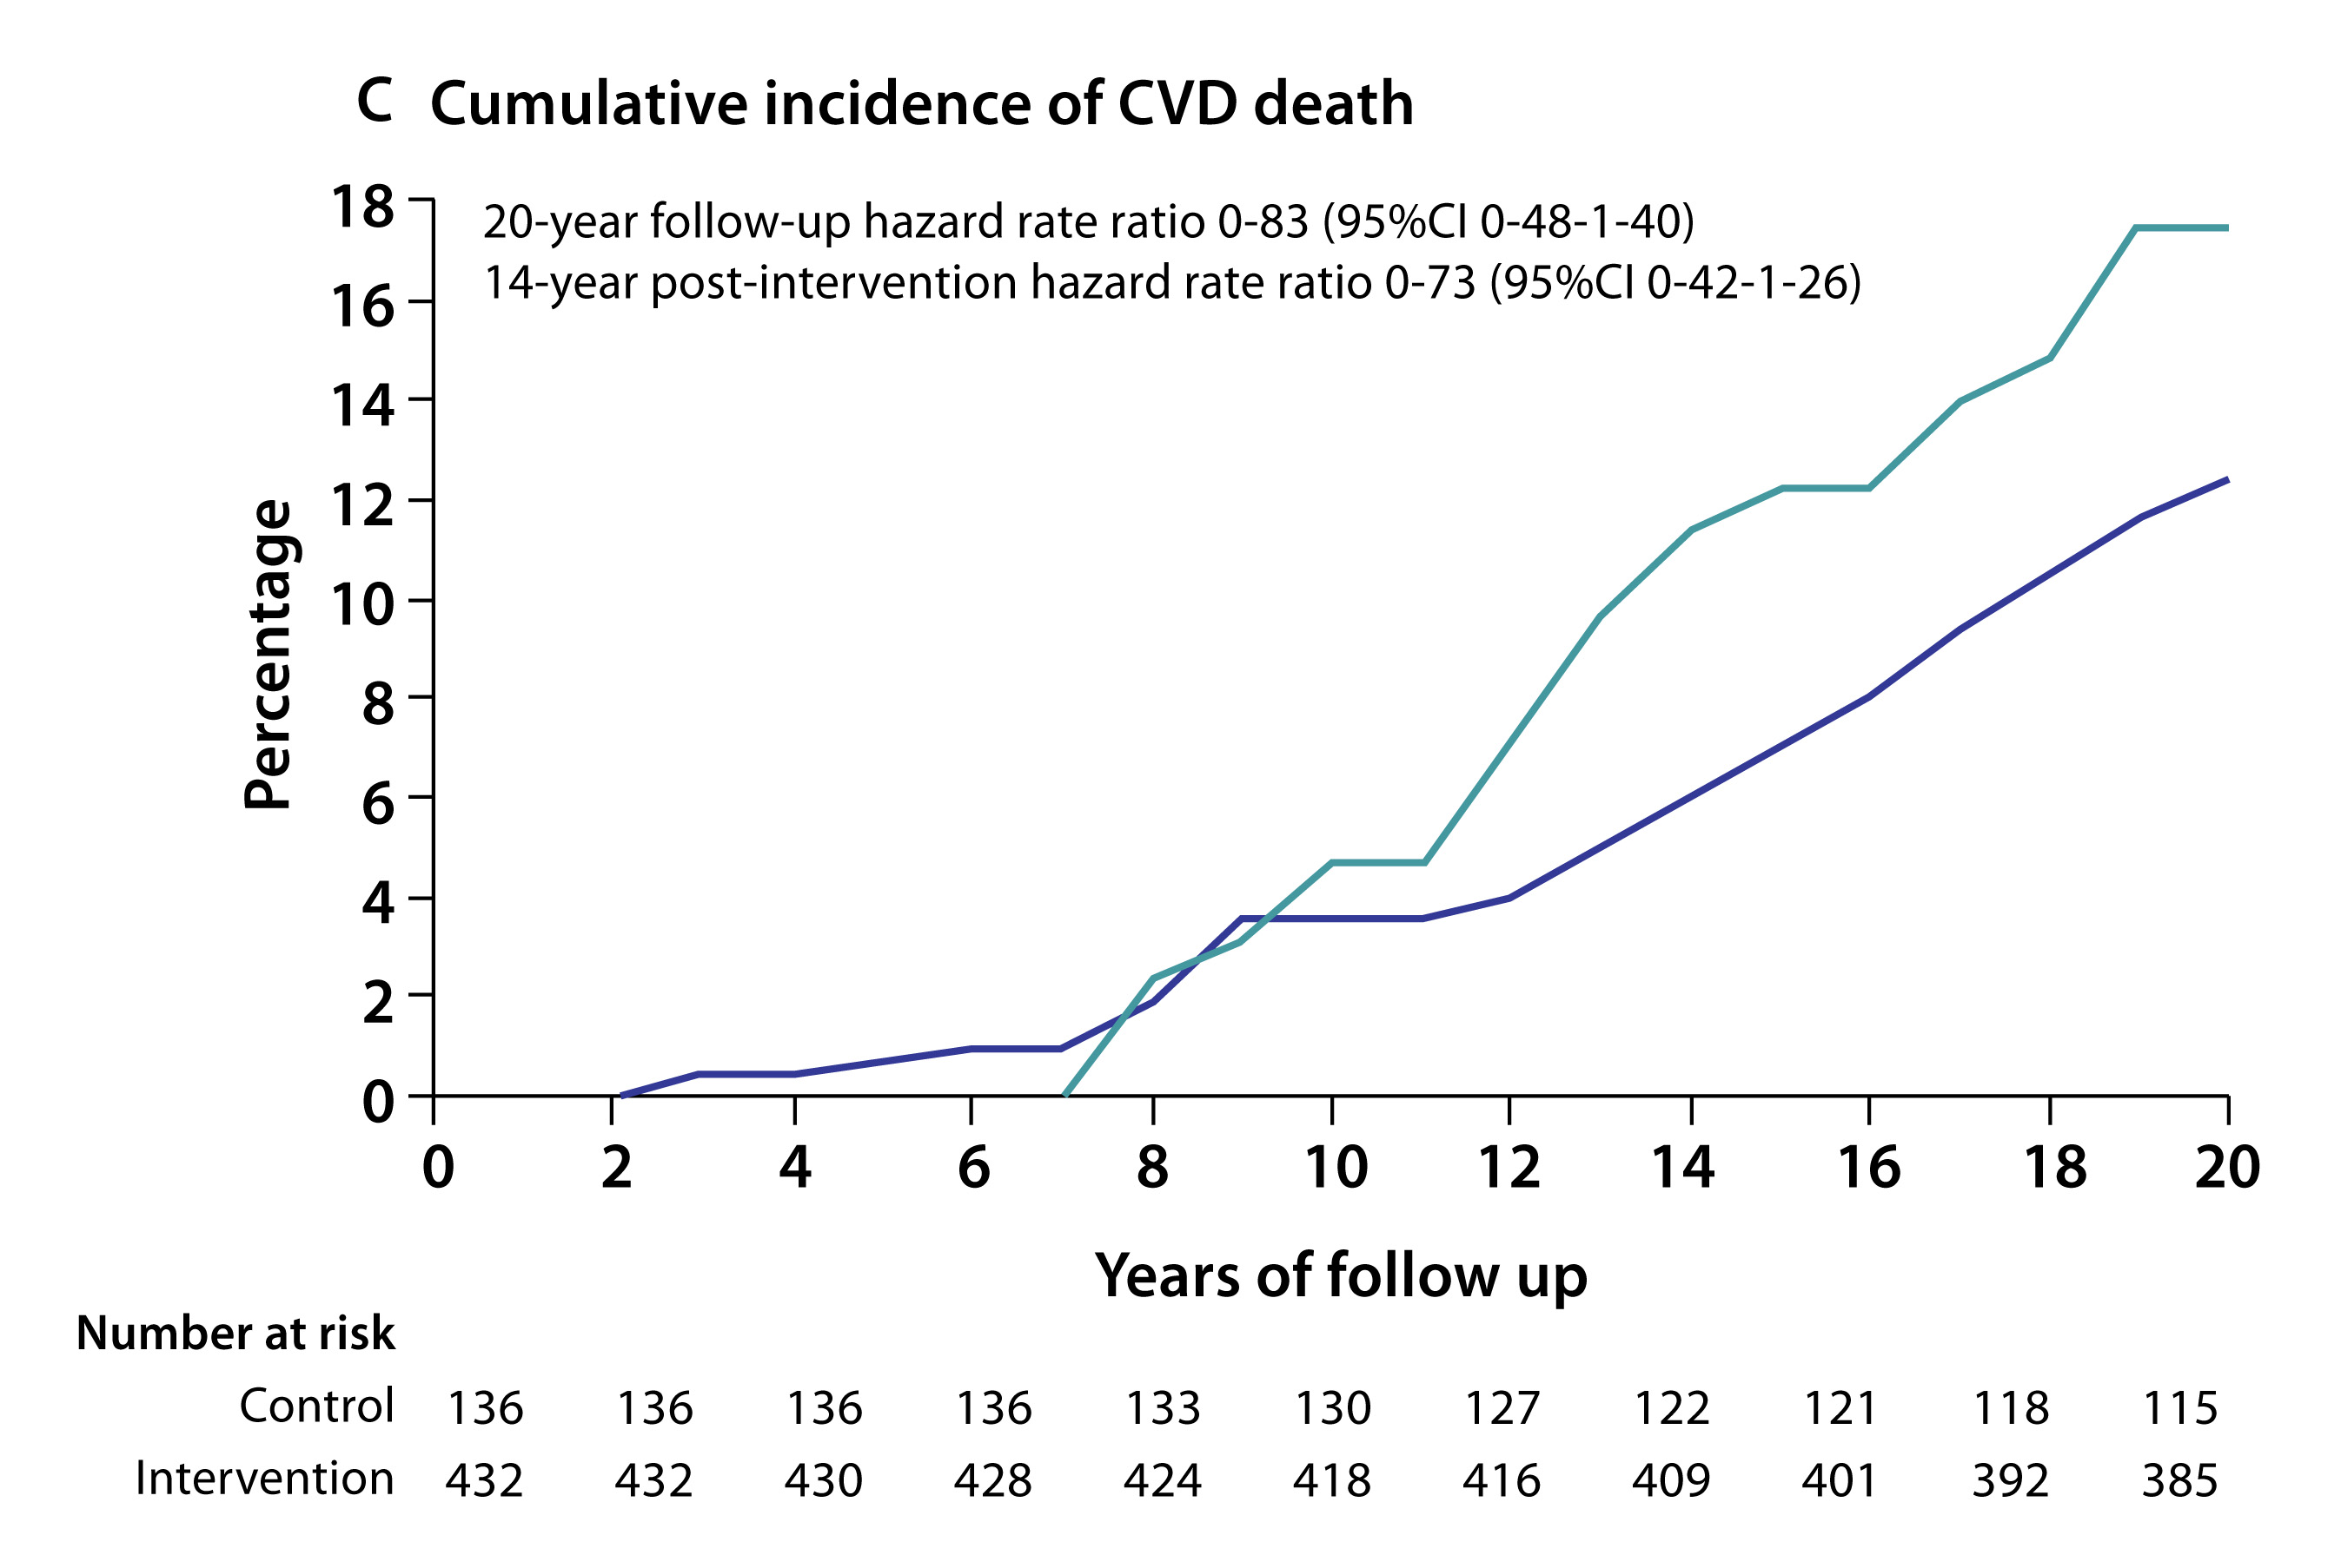
Effect of Intensive Lifestyle Intervention on CVD Death
Da Qing Diabetes Prevention Study
Control
Intervention
CVD, cardiovascular disease.
Li G, et al. Lancet. 2008;371:1783-1789.

Slide 78
Dyslipidemia management
Prediabetes Comorbidities and Complications

Slide 79
Common Secondary Causes of Dyslipidemia
Affected lipids | Conditions
↑ Total cholesterol and LDL-C | Hypothyroidism Nephrosis Dysgammaglobulinemia (systemic lupus erythematosus, multiple myeloma) Progestin or anabolic steroid treatment Cholostatic diseases of the liver due to abnormal lipoproteins, as in primary biliary cirrhosis Protease inhibitors for treatment of HIV infection
↑ Triglycerides and VLDL-C | Chronic renal failure T2D Obesity Excessive alcohol intake Hypothyroidism Antihypertensive medications (thiazide diuretics and b-adrenergic blocking age Corticosteroid therapy (or severe stress that increases endogenous corticosteroids) Orally administered estrogens, oral contraceptives, pregnancy Protease inhibitors for treatment of HIV infection
HIV, human immunodeficiency virus; LDL-C, low-density lipoprotein cholesterol; T2D, type 2 diabetes; VLDL-C, very low-density lipoprotein cholesterol.
Jellinger P, et al. Endocr Practice. 2017;23:479-497; NHLBI. NIH Publication No. 02-5215. 2002; Rodbard HW, et al. Endocr Pract. 13(Suppl 1):1-68; Vodnala D, et al. Am J Cardiol. 2012;110(6):823-825.
Notes:
Table 11

Slide 80
Intensive LDL-C Lowering Reduced CV Events in Patients With Low Baseline LDL-C
Cholesterol Treatment Trialists 2010*
For each 39 mg/dL reduction in LDL-C:
Individuals with baseline LDL-C <77 mg/dL had a 29% further reduction in major vascular events (P=0.007)
Those with baseline LDL-C <70 mg/dL had a 37% further reduction in major vascular events (P=0.004)
*Meta-analysis of randomized controlled trials of major vascular events (coronary death, myocardial infarction, coronary revascularization, and ischemic stroke) with at least 1,000 patients and ≥2 years of more vs. less intense statin dosage (N=169,138).
CV, cardiovascular; LDL-C, low-density lipoprotein cholesterol.
Cholesterol Treatment Trialists’ Collaboration. Lancet 2010;376:1670-1681; Jellinger P, et al. Endocr Practice. 2017;23:479-497.

Slide 81
AACE Lipid Goals by ASCVD Risk
Risk Category | Risk factors*/10-year risk† | Treatment goals (mg/dL)
 |  | LDL-C | Non-HDL-C | Apo B
Extreme risk | Progressive ASCVD including unstable angina in patients after achieving LDL-C <70 mg/dL Established clinical CVD in patients with diabetes, stage 3 or 4 CKD, or HeHF History of premature ASCVD (age <55 male, <65 female) | <55 | <80 | <70
Very high risk | Established or recent hospitalization for ACS or coronary, carotid, or peripheral vascular disease, or 10-year risk >20% Diabetes or stage 3 or 4 CKD plus ≥1 additional risk factor(s) HeHF | <70 | <100 | <80
High risk | ≥2 risk factors and 10-year risk 10-20% Diabetes or stage 3 or 4 CKD with no other risk factors | <100 | <130 | <90
Moderate risk | ≤2 risk factors and 10-year risk <10% | <100 | <130 | <90
Low risk | 0 risk factors | <130 | <160 | NR
*High LDL-C, PCOS, cigarette smoking, hypertension, low HDL-C, family history of CAD, stage 3 or 4 CKD, coronary calcification, and age ≥45 years in men and ≥55 years in women.
†Framingham risk score.
ASCVD, atherosclerotic cardiovascular disease; CAD, coronary artery disease; CKD, chronic kidney disease; HDL-C, high density lipoprotein cholesterol; HeHF, heterozygous familial hypercholesterolemia; LDL-C low density lipoprotein cholesterol; NR, not recommended; PCOS, polycystic ovary syndrome.
Jellinger PS, et al. Endocr Pract. 2017;23(suppl 2):1-87.

Slide 82
Classification of Elevated Triglyceride Levels
TG levels that are even moderately elevated (≥150 mg/dL) may identify individuals at risk for the insulin resistance syndrome. TG levels ≥200 mg/dL may indicate a substantial increase in ASCVD risk. Hypertriglyceridemia is also commonly associated with a procoagulant state and hypertension.
TG category | TG concentration (mg/dL) | TG goal
Normal | <150 | <150 mg/dL
Borderline high | 150-199
High | 200-499
Very high | ≥500
ASCVD, atherosclerotic cardiovascular disease; TG, triglycerides.
Jellinger P, et al. Endocr Practice. 2017;23:479-497.

Slide 83
Very Low LDL-C Levels and Risk for Major CV Events
Meta-analysis of 8 Statin Trials (Moderate- to High-Intensity Dosing)
Very low
LDL-C levels,
lowest risk
Current
“very high” risk goals
Current “high” risk goals
Adjusted* Hazard Ratio for Major CV Events
LDL-C, ApoB, non-HDL-C Achieved On-Trial Atherogenic Cholesterol and Lipoprotein Concentration (mg/dL)
*Adjusted for sex, age, smoking, diabetes, SBP, HDL-C, and trial.
** >200 mg/dL for non-HDL-C.
Apo, apolipoprotein; CV, cerebrovascular; HDL-C, high-density lipoprotein cholesterol; LDL-C, low-density lipoprotein cholesterol SBP, systolic blood pressure.
Boekholdt SM, et al. J Am Coll Cardiol. 2014;64(5):485-494.

Slide 84
IMPROVE-IT: Improved Reduction of Outcomes, Vytorin Efficacy International Trial
Trial design: Patients with recent ACS were randomized 1:1 to either ezetimibe 10 mg + simvastatin 40 mg or simvastatin 40 mg and followed for a median of 6 years
Primary composite CV endpoint
Results
Primary endpoint (CV death/MI/UA/coronary revasc/stroke/moderate/severe bleeding) for ezetimibe/simvastatin vs. simvastatin: 32.7% vs. 34.7% (HR 0.94, 95% CI 0.89-0.99; P=0.016)
MI: 13.1% vs. 14.8%, P=0.002; stroke: 4.2% vs. 4.8%, P=0.05; CVD/MI/stroke: 20.4% vs. 22.2%, P=0.003
Median LDL follow-up average: 53.7 vs. 69.5 mg/dL
Conclusions
In patients with high-risk ACS, ezetimibe 10 mg/simvastatin 40 mg was superior to simvastatin 40 mg alone in reducing adverse CV events
This is the first study powered for clinical outcomes to show a benefit with a non-statin agent
Reaffirms the “lower is better” hypothesis with LDL-C
Abbreviations: ACS, acute coronary syndrome; CV, cardiovascular; CVD, cardiovascular disease; LDL, low-density lipoprotein; LDL-C, low-density lipoprotein cholesterol; MI, myocardial infarction.
Cannon CP, et al. N Engl J Med. 2015;372:2387-2397.
Notes:
Cannon IMPROVE-IT 2015

Slide 85
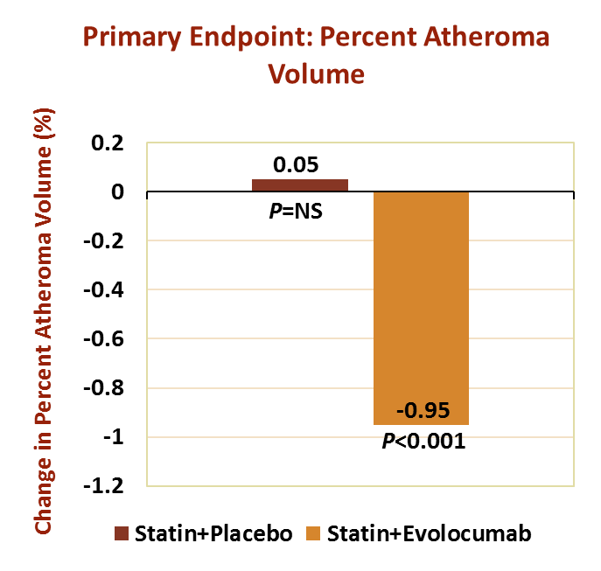
GLAGOV
Trial design: Patients with CAD and elevated LDL-C on statin therapy were randomized to SQ evolocumab (n=484) vs SQ placebo (n=486).
Results
Nominal change in percent atheroma volume at 78 weeks: -0.95% in the evolocumab group vs. 0.05% in the placebo group (P<0.001 for between-group comparison)
Patients with plaque regression: 64.3% with evolocumab vs. 47.3% with placebo (P<0.001)
Major adverse cardiac events: 12.2% with evolocumab vs. 15.3% with placebo
Conclusions
Among patients with angiographic evidence of CAD on chronic statin therapy, the PCSK9 inhibitor evolocumab resulted in a greater change in percent atheroma volume and a greater proportion of patients with plaque regression
CAD, coronary artery disease; GLAGOV, Global Assessment of Plaque Regression With a PCSK9 Antibody as Measured by Intravascular Ultrasound; LDL-C, low-density lipoprotein cholesterol; PCSK9, proprotein convertase subtilisin/kexin type 9; SQ, subcutaneous.
Nicholls SJ, et al. JAMA. 2016;316:2373-2384.

Slide 86
FOURIER Trial
This randomized, double-blind, placebo-controlled trial investigated the effects of adding evolocumab to high-intensity statin therapy compared with high-intensity statins alone
Participants were recruited from 12 prior evolocumab trials
Median patient follow-up was 2.2 years; study results included data for over 27,500 individuals with clinically evident atherosclerotic disease and baseline LDL-C levels ≥70 mg/dL and HDL-C levels ≥100 mg/dL
All study participants were receiving statin therapy with or without ezetimibe, and the evolocumab and placebo groups had the same baseline LDL-C (92 mg/dL)
FOURIER, Further Cardiovascular Outcomes Research With PCSK9 Inhibition in Subjects with Elevated Risk; LDL-C, low-density lipoprotein cholesterol; MI, myocardial infarction.
Sabatine MS, et al. NEJM. 2017;376:1713-1722.
Notes:
Outcomes from the Further Cardiovascular Outcomes Research with PCSK9 Inhibition in Subjects With Elevated Risk (FOURIER) trial support extremely tight lipid control for individuals at very high or extreme cardiovascular risk. (488 [EL 1; RCT]). This randomized, double-blind, placebo-controlled trial investigated the effects of adding evolocumab to high-intensity statin therapy compared with high-intensity statins alone on a composite cardiovascular outcome which included MI, cardiovascular death, stroke, coronary revascularization, or hospitalization for unstable angina. Median patient follow-up was 2.2 years. Study results included data for over 27,500 individuals (representing 59,865 patient-years) with clinically evident atherosclerotic disease and baseline LDL-C levels ≥70 mg/dL and HDL-C levels ≥100 mg/dL. All study participants were receiving statin therapy with or without ezetimibe, and the evolocumab and placebo groups had the same baseline LDL-C (92 mg/dL).

Slide 87
FOURIER Evolocumab Study LDL-C Levels Over Time
No. at Risk
Placebo | 13,779 | 13,251 | 13,151 | 12,954 | 12,596 | 12,311 | 10,812 | 6926 | 3352 | 790
Evolocumab | 13,784 | 13,288 | 13,144 | 12,964 | 12,645 | 12,359 | 10,902 | 6958 | 3323 | 768
Absolute difference (mg/dL) |  | 54 | 58 | 57 | 56 | 55 | 54 | 52 | 53 | 50
Percentage difference |  | 57 | 61 | 61 | 59 | 58 | 57 | 55 | 56 | 54
P-value |  | <0.001 | <0.001 | <0.001 | <0.001 | <0.001 | <0.001 | <0.001 | <0.001 | <0.001
FOURIER, Further Cardiovascular Outcomes Research with PCSK9 Inhibition in Subjects With Elevated Risk trial; LDL-C, low-density lipoprotein cholesterol.
Sabatine MS, et al. NEJM. 2017;376:1713-1722.

Slide 88
FOURIER Primary and Secondary Endpoints
At 26 months, extremely tight lipid control with evolocumab led to a 15% decrease in risk for the primary composite endpoint and 20% decrease in risk for a secondary composite endpoint
The primary endpoint included MI, cardiovascular death, stroke, coronary revascularization, or hospitalization for unstable angina
The secondary endpoint included cardiovascular death, MI, or stroke
Beyond the second year of follow-up, the risk reduction increased to 20% for the primary endpoint and to 25% for the secondary endpoint
For singular endpoints at 26 months, very tight lipid control reduced the risk of MI by 27%, stroke by 21%, and coronary revascularization by 22%
FOURIER, Further Cardiovascular Outcomes Research with PCSK9 Inhibition in Subjects With Elevated Risk trial; LDL-C, low-density lipoprotein cholesterol; MI, myocardial infarction.
Sabatine MS, et al. NEJM. 2017;376:1713-1722.

Slide 89
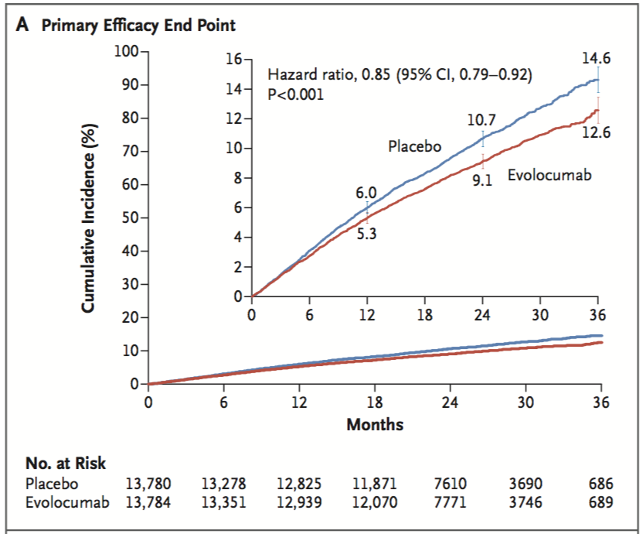
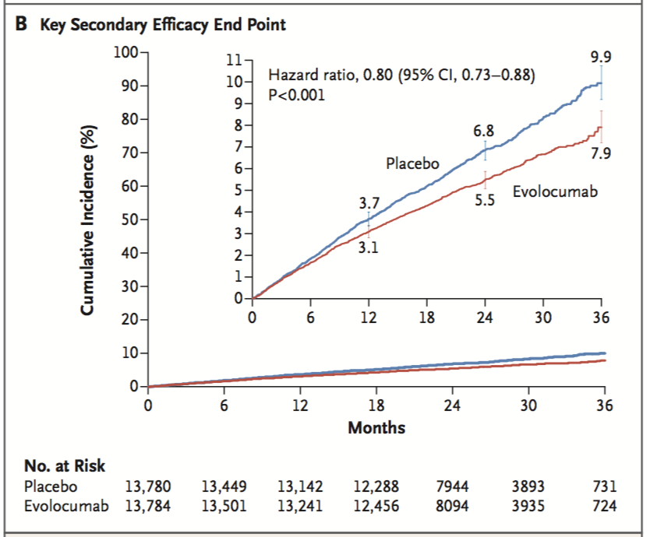
FOURIER Evolocumab Study Endpoints
Cumulative event rates for the primary efficacy endpoint
(Composite of cardiovascular death, MI, stroke,
hospitalization for unstable angina, or coronary revascularization)
Cumulative rates for the key secondary efficacy endpoint (Composite of cardiovascular death, MI, or stroke)
FOURIER, Further Cardiovascular Outcomes Research with PCSK9 Inhibition in Subjects With Elevated Risk trial; MI, myocardial infarction.
Sabatine MS, et al. NEJM. 2017;376:1713-1722.

Slide 90
Effect of Metformin and Lifestyle on Total and LDL-C in Prediabetes
Diabetes Prevention Program
(N=3234)
Total Cholesterol
LDL-C
Baseline (mg/dL) 202 127
Change in Lipids (%)
LDL-C, low-density lipoprotein cholesterol.
DPP Research Group. Diabetes Care. 2005;28:2472–2479. Ratner R, et al. Diabetes Care. 2005;28:888-894.

Slide 91
Atherogenic Dyslipidemia: The Dyslipidemic Triad
High TG
Low HDL-C
Small, dense LDL particles
↑ Non-HDL-C
Triglycerides
VLDL
Chylomicrons
TG-rich lipoprotein remnants
Small, dense LDL
HDL-C, high-density lipoprotein cholesterol; LDL, low-density lipoprotein; TG, triglycerides; VLDL, very low-density lipoprotein.
Jellinger PS. Endocr Pract. 2017 Feb 3. doi: 10.4158/EP171764.GL. [Epub ahead of print]

Slide 92
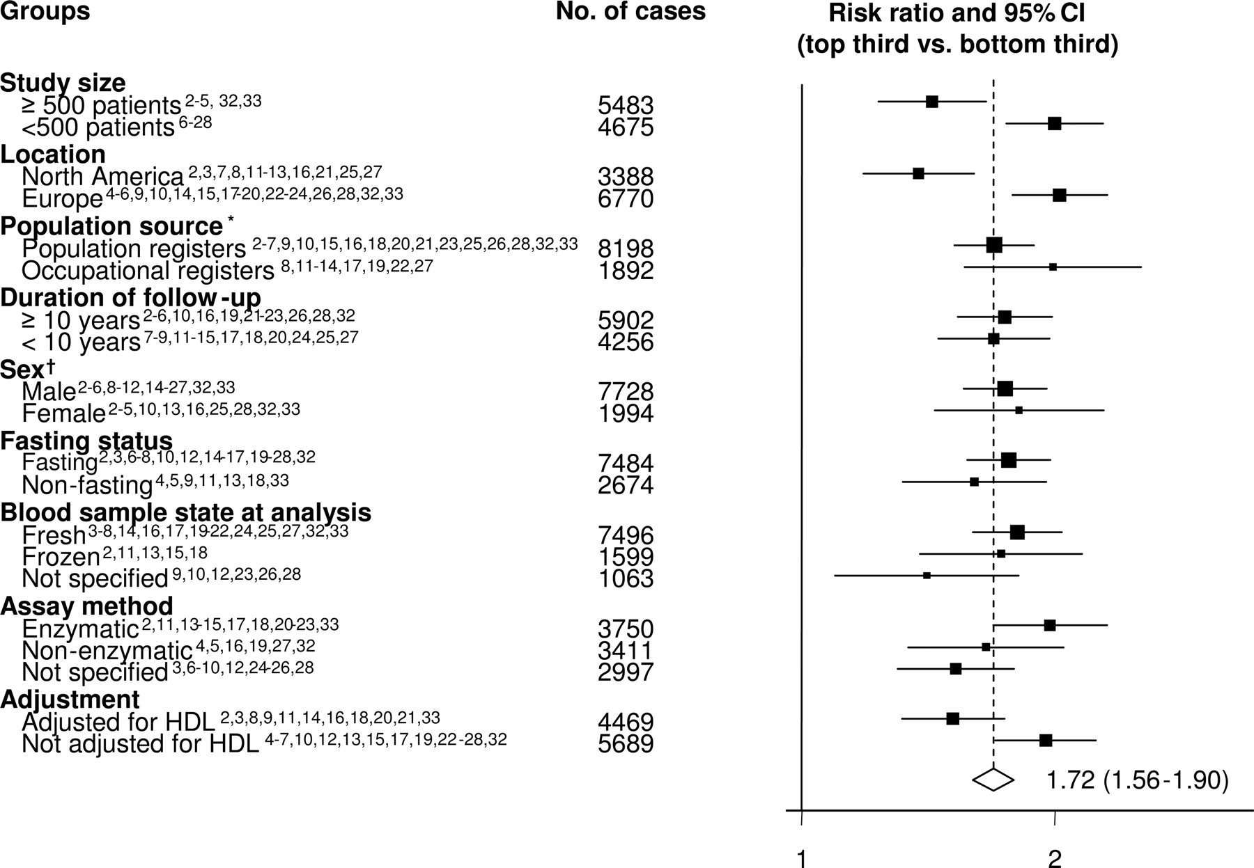
Risk of CHD With Hypertriglyceridemia
Updated Meta-analysis
(N=262,525; 29 Prospective Studies)
Risk ratio and 95% CI for top third vs bottom third TG values
up
Total 10,158
P<0.001
CHD, coronary heart disease; HDL, high-density lipoprotein; TG, triglyceride.
Sarwar N, et al. Circulation. 2007;115:450-458.

Slide 93
Joint Effects of Serum Triglycerides, LDL-C, and HDL-C on CHD Risk
Helsinki Heart Study Analysis: Relative Risk of Cardiac Events Among Placebo Patients
3.82 (2.20-6.63)
Mean baseline (mg/dL)
TC: 289
TG: 176
HDL-C: 47
LDL-C: 189
Non-HDL-C: 242
Relative Risk of Cardiac Event
1.19 (0.61-2.32)
1
(Reference)
1.05 (0.56-2.00)
TG ≤200 mg/dL
TG >200 mg/dL
TG ≤200 mg/dL
TG >200 mg/dL
LDL/HDL >5
LDL/HDL ≤5
CHD, coronary heart disease; HDL, high-density lipoprotein; HDL-C, high-density lipoprotein cholesterol; HHS, Helsinki Heart Study; LDL, low-density lipoprotein; LDL-C, low-density lipoprotein cholesterol; TC, total cholesterol; TG, triglycerides.
Manninen V, et al. Circulation. 1992;85:37-45.

Slide 94
Effect of Triglycerides and HDL-C on Major Coronary Events
Munster Heart Study (PROCAM), 8-Year Follow-up
(N=4639; 258 total deaths)
Deaths per 1000 Patients
TG (mg/dL)
The fewest deaths (n=15) occurred in the subgroup with TG <150 and HDL-C >55 mg/dL
HDL-C, high-density lipoprotein cholesterol; TG, triglyceride.
Assmann G, et al. Eur Heart J. 1998;19(suppl):A2-A11.

Slide 95
Fibrate Benefits Are Greatest in Patients with High TG and Low HDL-C
Bezafibrate Infarction Prevention Study
Any BL HDL-C
BL HDL-C <35 mg/dL
BL HDL-C ≥35 mg/dL
41.8
(P=0.02)
39.5
(P=0.02)
35.9
(P=0.02)
Patients (%)
Baseline Triglycerides (mg/dL)
*Fatal or nonfatal myocardial infarction or sudden death; arrows denote statistically significant differences.
BL, baseline; HDL-C, high-density lipoprotein cholesterol; TG, triglycerides.
BIP Study Group. Circulation. 2000;102:21.

Slide 96
Fibrates in HHS and VA-HIT
HHS showed that fibrates are highly effective at lowering TG, and that reducing TG is associated with fewer ASCVD events and significantly reduces nonfatal MI¹
Gemfibrozil use resulted in a 34% reduction in coronary heart disease endpoints (fatal and nonfatal MI or cardiac death)
An 18-year HHS follow-up showed that TG reduction with fibrates significantly lowered the ASCVD mortality rate²
VA-HIT showed that increasing HDL-C and lowering TG in individuals with ASCVD whose primary lipid abnormality was low HDL-C significantly reduced the rate of coronary events, even without any change in LDL-C levels³
Gemfibrozil use resulted in a 22% reduction in the relative risk for nonfatal MI or coronary death and reduced nonfatal MI, coronary death, or stroke by 24%³
ASCVD, atherosclerotic cardiovascular disease; HDL-C, high-density lipoprotein cholesterol; HHS, Helsinki Heart Study; LDL-C, low-density lipoprotein cholesterol; MI, myocardial infarction; TG, triglyceride; VA-HIT, Veterans Affairs Cooperative Studies Program High-Density Lipoprotein Cholesterol Intervention Trial.
1. Frick MH, et al. N Engl J Med. 1987;317:1237-1245; 2. Tenkanen L, et al. Arch Intern Med. 2006;166:743-748; 3. Rubins HB, et al. N Engl J Med. 1999;341:410-418.

Slide 97
Effect of Metformin and Lifestyle on Triglycerides and HDL-C in Prediabetes
Diabetes Prevention Program
(N=3234)
Triglycerides
HDL-C
Baseline (mg/dL) 172 40
Change in Lipids (mg/dL)
HDL-C, high-density lipoprotein cholesterol.
DPP Research Group. Diabetes Care. 2005;28:2472–2479. Ratner R, et al. Diabetes Care. 2005;28:888-894.

Slide 98
Intensive Lifestyle Intervention Reduces Dyslipidemia
Diabetes Prevention Program
(N=3234)
* †
*P<0.001 vs placebo; †P=0.015 vs metformin.
Ratner R, et al. Diabetes Care. 2005;28:888-894.

Slide 99
Statins: Primary Metabolic Effects and Main Considerations
Metabolic Effects
Primarily ↓ LDL-C 21%-55% by competitively inhibiting rate-limiting step of cholesterol synthesis in the liver, leading to upregulation of hepatic LDL receptors
Effects on TG and HDL-C are less pronounced (↓ TG 6%-30% and ↑ HDL-C 2%-10%)
Main Considerations
Liver function test prior to therapy and as clinically indicated thereafter Myalgias and muscle weakness in some individuals Potential for drug-drug interaction between some statins and CYP450 3A4 inhibitors, cyclosporine, warfarin, and protease inhibitors Myopathy/rhabdomyolysis in rare cases; increased risk with coadministration of some drugs (see product labeling) Simvastatin dosages should not exceed 40 mg in most individuals; dosages of 80 mg are no longer recommended except in those who have tolerated 80 mg for 12 months or more without muscle toxicity Do not exceed 20 mg simvastatin daily with amlodipine or ranolazine Plasma elevations of rosuvastatin may be higher among Asian persons than other ethnic groups New-onset diabetes is increased in individuals treated with statins; however, it is dose-related, occurs primarily in individuals with MetS, appears to be less common with pravastatin and possibly pitavastatin, and occurs overall to a lesser extent than the associated decrease in ASCVD
ASCVD, atherosclerotic cardiovascular disease; HDL-C, high-density lipoprotein cholesterol; LDL, low-density lipoprotein; LDL-C, low-density lipoprotein cholesterol; MetS, metabolic syndrome; TG, triglycerides.
Bissonnette S, et al. Can J Cardiol. 2006;22:1035-1044; Denke M, et al. Diab Vasc Dis Res. 2006;3:93-102; Jellinger P, et al. Endocr Practice. 2017;23:479-497; Preiss D, et al. JAMA. 2011;305: 2556-2564.

Slide 100
Statin Starting Dosages and Dosage Ranges
Agent | Usual recommended starting daily dosage | Dosage range | Administration
Lovastatin | 20 mg | 10-80 mg | Oral
Pravastatin | 40 mg | 10-80 mg | Oral
Simvastatin | 20-40 mg | 5-80 mg* | Oral
Fluvastatin | 40 mg | 20-80 mg | Oral
Atorvastatin | 10-20 mg | 10-80 mg | Oral
Rosuvastatin | 10 mg | 5-40 mg | Oral
Pitavastatin | 2 mg | 2-4 mg | Oral
*Simvastatin 80 mg not approved for therapy unless individual has been on treatment for more than 1 year without myopathy.
Crestor (rosuvastatin calcium); [PI]; 2016; Jellinger P, et al. Endocr Practice. 2017;23:479-497; Lescol (fluvastatin sodium) [PI]; 2012 Lipitor (atorvastatin calcium) [PI]; 2015; Livalo (pitavastatin) [PI]; 2013; ; Mevacor (lovastatin) [PI]; 2014; Pravachol (pravastatin sodium) [PI]; 2016; Zocor (simvastatin) [PI]; 2015.
Notes:
Table 18

Slide 101
Statin Benefits Across a Range of Baseline Levels
Cholesterol Treatment Trialists’ Collaboration
LDL-C 90-130 mg/dL shows same benefit as LDL-C 50-90 mg/dL
 | Events (% per annum) |  | RR (CI) per 1 mmol/L reduction in LDL-C
 | Statin | Control
<2 mmol/L (<77 mg/dL) | 910 (4.1%) | 1,012 (4.6%) |  | 0.78 (0.61-0.99)
≥2 to <2.5 mmol/L (77-96 mg/dL) | 1,528 (3.6%) | 1,729 (4.2%) |  | 0.77 (0.67-0.89)
≥2.5 to <3.0 mmol/L (97-116 mg/dL) | 1,866 (3.3%) | 2,225 (4.0%) |  | 0.77 (0.70-0.85) | P=0.3
≥3.0 to <3.5 mmol/L (117-135 mg/dL) | 2,007 (3.2%) | 2,454 (4.0%) |  | 0.76 (0.70-0.82)
≥3.5 mmol/L (>136 mg/dL) | 4,508 (3.0%) | 5,736 (3.9%) |  | 0.80 (0.76-0.83)
Total | 10,973 (3.2%) | 13,350 (4.0%) |  | 0.78 (0.76-0.80)
1 mmol/L = 38.6 mg/dL
LDL-C, low-density lipoprotein cholesterol.
Baigent C, et al. Lancet. 2010;376:1670-1681.
Notes:
Cholesterol conversions based on 38.6 mg/dL: 2mmol/l=<77; 2-2.5 = 77-97; 2.5 to 3.0=97-116; 3 to 3.5=117-135; greater than 3.5= >136

Slide 102
Effect on CHD and Diabetes Primary Prevention
Cholesterol Treatment Trialists’ Collaboration
 | Events (% per annum) |  | RR (CI) per 1 mmol/L reduction in LDL-C
Previous Vascular Disease | Statin | Control
CHD | 8,395 (4.5%) | 10,123 (5.6%) |  | 0.79 (0.76-0.82)
No CHD, vascular | 674 (3.1%) | 802 (3.7%) |  | 0.81 (0.71-0.92) | P=0.3
None | 1,904 (1.4%) | 2,425 (1.8%) |  | 0.75 (0.69-0.82)
Diabetes
Type 1 diabetes | 145 (4.5%) | 192 (6.0%) |  | 0.77 (0.58-1.01)
Type 2 diabetes | 2,494 (4.2%) | 2,920 (5.1%) |  | 0.80 (0.74-0.86) | P=0.8
No diabetes | 8,272 (3.2%) | 10,163 (4.0%) |  | 0.78 (0.75-0.81)
1 mmol/L = 38.6 mg/dL.
CHD: coronary heart disease; CI, confidence interval; LDL-C, low-density lipoprotein cholesterol; RR: relative risk.
Baigent C, et al. Lancet. 2010;376:1670-1681.
Notes:
Cholesterol conversions based on 38.6 mg/dL: 2mmol/l=<77; 2-2.5 = 77-97; 2.5 to 3.0=97-116; 3 to 3.5=117-135; greater than 3.5= >136

Slide 103
Comparison of Statin Effects on Lipids After 6 Weeks of Treatment
Men and Women With LDL-C ≥160 and ≤250 mg/dL (N=2,431)
Statin | Dosage range, mg daily | TC (mg/dL) | LDL-C (mg/dL) | HDL-C (mg/dL) | TG (mg/dL)
Lovastatin | 20-80 | ↓ 21 to ↓ 36 | ↓ 29 to ↓ 48 | ↑ 4.6 to ↑ 8.0 | ↓ 12 to ↓ 13
Pravastatin | 10-40 | ↓15 to ↓ 22 | ↓ 20 to ↓30 | ↑ 3.2 to ↑ 5.6 | ↑ 8 to ↓ 13
Simvastatin | 10-80* | ↓ 20 to ↓ 33 | ↓ 28 to ↓ 46 | ↑ 5.2 to ↑ 6.8 | ↓ 12 to ↓ 18
Fluvastatin | 20-40 | ↓ 13 to ↓ 19 | ↓ 17 to ↓ 23 | ↑ 0.9 to ↓ 3.0 | ↓ 5 to ↓ 13
Atorvastatin | 10-80 | ↓ 27 to ↓ 39 | ↓ 37 to ↓ 51 | ↑ 2.1 to ↑ 5.7 | ↓ 20 to ↓ 28
Rosuvastatin | 10-40 | ↓ 33 to ↓ 40 | ↓ 45 to ↓ 55 | ↑ 7.7 to ↑ 9.6 | ↓ 20 to ↓ 26
*Not to be used at dosages of 80 mg unless individual has been on treatment for more than 12 months.
HDL-C, high-density lipoprotein cholesterol; LDL-C, low-density lipoprotein cholesterol; TC, total cholesterol; TG, triglycerides.
AAP NCEP Pediatrics. 1992;89:525-584; Daniels SR, et al. EPIGCVHRRCAFR, 2012; Jellinger P, Handelsman Y, Rosenblit P, et al. Endocr Practice. 2017;23:479-497; Jones P, et al. Am J Cardiol. 1998;81:582-587; Jones PH, et al. Am J Cardiol. 2003; 92:152-160; ; LIPID Study Group. N Engl J Med. 1998;339:1349-1357; Pfeffer MA, et al. J Am Coll Cardiol. 1999;33:125-130; Plehn JF, et al. Circulation. 1999;99:216-223.
Notes:
Table 19

Slide 104
PCSK9 Inhibitor Starting Dosages and Dosage Ranges
Agent | Usual recommended starting daily dosage | Dosage range | Administration
Alirocumab | 75 mg every 2 weeks | 75-150 mg every 2 weeks | SC
Evolocumab | 140 mg every 2 weeks or 420 mg once monthly | Not applicable | SC
Metabolic Effects
↓LDL-C 48%-71%, ↓ non-HDL-C 49%-58%, ↓TC 36%-42%, ↓Apo B 42%-55% by inhibiting PCSK9 binding with LDLRs, increasing the number of LDLRs available to clear LDL, and lowering LDL-C levels
Main Considerations
Require subcutaneous self-injection; refrigeration generally needed
Overall levels of adverse reactions and discontinuation very low
Adverse reactions with significantly different rates between drug and placebo were: local injection site reactions and influenza
The most common adverse reactions with similar rates for drug vs. placebo were:
Alirocumab: nasopharyngitis, influenza, urinary tract infections, diarrhea, bronchitis, and myalgia
Evolocumab: nasopharyngitis, back pain, and upper respiratory tract infection
Apo, apolipoprotein; HDL-C, high-density lipoprotein cholesterol; LDL, low-density lipoprotein; LDL-C, low-density lipoprotein cholesterol; LDLR, low-density lipoprotein receptor; PCSK9, proprotein convertase subtilisin/kexin type 9; SC, subcutaneous injection; TC, total cholesterol.
Jellinger P, Handelsman Y, Rosenblit P, et al. Endocr Practice. 2017;23:479-497; Praluent (alirocumab) [PI] 2015; Repatha (evolocumab) [PI]; 2016.
Notes:
Table 18

Slide 105
Fibrate Starting Dosages and Dosage Ranges
Agent | Usual recommended starting daily dose | Dosage range | Administration
Fenofibrate | 48-145 mg | 48-145 mg | Oral
Gemfibrozil | 1200 mg | 1200 mg | Oral
Fenofibric acid | 45-135 mg | 45-135 mg | Oral
Metabolic Effects
Primarily ↓ TG 20%-35%, ↑ HDL-C 6%-18% by stimulating lipoprotein lipase activity
Fenofibrate may ↓ TC and LDL-C 20%-25%
Lower VLDL-C and LDL-C; reciprocal rise in LDL-C transforms the profile into a less atherogenic form by shifting fewer LDL particles to larger size
Fenofibrate ↓ fibrinogen level
HDL-C, high-density lipoprotein cholesterol; LDL, low-density lipoprotein, LDL-C, low-density lipoprotein cholesterol; TC, total cholesterol; TG, triglycerides; VLDL-C, very low-density lipoprotein cholesterol.
Aguilar-Salinas CA, et al. Metabolism. 2001;50:729-733; Athyros VG, et al. Coron Artery Dis. 1995;6:25-1256; Avellone G, et al. Blood Coagul Fibrinolysis. 1995;6:543-548; Bröijersen A, et al. Arterioscler Thromb Vasc Biol. 1996;16:511-516; Bröijersén A, et al. Thromb Haemost. 1996;76:171-176; Davidson MH, et al. Am J Cardiol. 2007;99:3C-18C; Farnier M, et al. Eur Heart J. 2005;26:897-905; Guyton JR, et al. Arch Intern Med. 2000;160:1177-1184; Hottelart C, et al. Nephron. 2002;92:536-541; Insua A, et al. Endocr Pract. 2002;8:96-101; Jellinger P, Handelsman Y, Rosenblit P, et al. Endocr Practice. 2017;23:479-497; Kockx M, et al. Thromb Haemost. 1997;78:1167-1172; Lopid (gemfibrozil) [PI] 2010; McKenney JM, et al. J Am Coll Cardiol. 2006;47:1584-1587; Syvänne M, et al. Atherosclerosis. 2004;172:267-272; Tricor (fenofibrate) [PI]; 2010; Trilipix (fenofibric acid) [PI]; 2016; Westphal S, et al. Lancet. 2001; 358:39-40.
Notes:
Table 18

Slide 106
Fibrates: Main Considerations
Gemfibrozil may ↑ LDL-C 10%-15%
GI symptoms, possible cholelithiasis
May potentiate effects of orally administered anticoagulants
Gemfibrozil may ↑ fibrinogen level
Gemfibrozil and fenofibrate can ↑ homocysteine independent of vitamin concentrations
May cause muscle disorders; myopathy/rhabdomyolysis when used with statin
Fibrates are associated with increased serum creatinine levels, which may not reflect renal dysfunction
Fenofibrate dose should be cut by two-thirds and gemofibrozil by one-half when eGFR is 15-60, and fibrates should be avoided when eGFR is <15
Can improve diabetic retinopathy
eGFR, estimated glomerular filtration rate; GI, gastrointestinal; LDL-C, low-density lipoprotein cholesterol.
Jellinger P, et al. Endocr Practice. 2017;23:479-497.

Slide 107
Bile Acid Sequestrant Starting Dosages and Dosage Ranges
Agent | Usual recommended daily dosage | Dosage range | Administration
Cholestyramine | 8-16 g | 4-24 g | Oral
Colestipol | 2 g | 2-16 g | Oral
Colesevelam | 3.8 g | 3.8-4.5 g | Oral
Metabolic Effects
Primarily ↓ LDL-C 15%-25% by binding bile acids and preventing their reabsorption in the ileum (causing hepatic cholesterol depletion and LDL-receptor upregulation)
Colesevelam ↓ glucose and hemoglobin A1C (~0.5%); FDA-approved to treat T2D
Main Considerations
May ↑ serum TG
Frequent constipation and/or bloating, which can reduce adherence
Many potential drug interactions (decreased drug absorption), less so with colesevelam (see product labeling)
May reduce absorption of folic acid and fat-soluble vitamins such as vitamins A, D, and K
FDA, Food and Drug Administration; LDL, low-density lipoprotein; LDL-C, low-density lipoprotein cholesterol; T2D, type 2 diabetes; TG, triglyceride.
Colestid (colestipol hydrochloride) [PI]; 2014; Jellinger P, et al. Endocr Practice. 2017;23:479-497; Prevalite (cholestyramine for oral suspension, USP) [PI]; 2015; WelChol (colesevelam hydrochloride) [PI]; 2014; Zieve FJ, et al. Ther. 2007;29:74-839:74-83.
Notes:
Table 18

Slide 108
Cholesterol Absorption Inhibitor Starting Dosages and Dosage Ranges
Agent | Usual recommended daily dosage | Dosage range | Administration
Ezetimibe | 10 mg | 10 mg | Oral
Ezetimibe/ simvastatin | 10/20 mg | 10/10 to 10/80 mg | Oral
Metabolic Effects
Primarily ↓ LDL-C 10%-18% by inhibiting intestinal absorption of cholesterol and decreasing delivery to the liver, leading to upregulation of hepatic LDL receptors
↓ Apo B 11%-16%
In combination with statins, additional ↓ LDL-C 25%, total ↓ LDL-C 34%-61%
In combination with fenofibrate, ↓ LDL-C 20%-22% and ↓ apo B 25%-26% without reducing ↑ HDL-C
Main Considerations
Myopathy/rhabdomyolysis (rare)
When coadministered with statins or fenofibrate, risks associated with those drugs remain (e.g., myopathy/ rhabdomyolysis, cholelithiasis)
Apo, apolipoprotein; HDL-C, high-density lipoprotein cholesterol; LDL-C, low-density lipoprotein cholesterol.
Bays HE, et al. Clin Ther. 2001;23:1209-1230; Bays HE, et al. Clin Ther. 2004;26:1758-1773; Bissonnette S, et al. Can J Cardiol. 2006;22:1035-1044; Brohet C, et al. Curr Med Res Opin. 2005;21:571-578; Denke M et al. Diab Vasc Dis Res. 2006;3:93-102; Dujovne CA, et al. Am J Cardiol. 2002;90:109-21097; Farnier M, et al. Eur Heart J. 2005;26:897-905; Gagne C, et al. Am J Cardiol. 2002;90:1084-1091; Jellinger P, et al. Endocr Practice. 2017;23:479-497; Knopp RH, et al. Int J Clin Pract. 2013. 57:363-368; McKenney JM, et al. J Am Coll Cardiol. 2006;47:1584-1587; Zetia (ezetimibe) [PI] 2013.
Notes:
Table 18

Slide 109
Omega-3 Fatty Acid Starting Dosages and Dosage Ranges
Agent | Usual recommended daily dosage | Dosage range | Administration
Omega-3-acid ethyl esters (Lovaza) | 4 g | 4 g | Oral
Icosapent ethyl (Vascepa) | 4 g | 4 g | Oral
Metabolic Effects
↓ TG 27%-45%, TC 7%-10%, VLDL-C 20%-42%, apo B 4%, and non-HDL-C 8%-14% in individuals with severe hypertriglyceridemia most likely by reducing hepatic VLDL-TG synthesis and/or secretion and enhancing TG clearance from circulating VLDL particles. Other potential mechanisms of action include: increased β-oxidation; inhibition of acyl-CoA; 1,2-diacylglyceral acyltransferase; decreased hepatic lipogenesis; and increased plasma lipoprotein activity
Icosapent ethyl ↓ LDL-C 5%, whereas, omega-3-acid ethyl esters ↑ LDL-C 45%
Apo, apolipoprotein; HDL-C, high-density lipoprotein cholesterol; LDL-C, low-density lipoprotein cholesterol; TC, total cholesterol; TG, triglycerides; VLDL, very low-density lipoprotein.
Jellinger P, et al. Endocr Practice. 2017;23:479-497; Lovaza (omega-3-acid ethyl esters) [PI]; 2015; Vascepa (icosapent ethyl) [PI]; 2016.

Slide 110
Omega-3 Fatty Acids: Main Considerations
Assess TG levels prior to initiating and periodically during therapy
Omega-3-acid ethyl esters can increase LDL-C levels. Monitor LDL-C levels during treatment
May prolong bleeding time. Monitor coagulation status periodically in patients receiving treatment with omega-3 fatty acids and other drugs affecting coagulation
Monitor ALT and AST levels periodically during treatment in patients with hepatic impairment. Some patients may experience increases in ALT levels only
Exercise caution when treating patients with a known hypersensitivity to fish and/or shellfish
The effect of omega-3 fatty acids on cardiovascular morbidity and mortality and the risk of pancreatitis has not been determined in patients with severe hypertriglyceridemia
In patients with paroxysmal or persistent atrial fibrillation, therapy with omega-3-acid ethyl esters may be associated with increased frequency of symptomatic AF or flutter, especially within the first 2 to 3 months after initiation
Most common adverse events include arthralgia (2.3%), eructation (4%), dyspepsia (3%), and taste perversion (4%). May also experience constipation, gastrointestinal disorders, vomiting, rash, or pruritus
Should be used with caution in nursing mothers and only be used in pregnant women if the benefits of treatment outweigh the potential risk of fetal harm
AF, atrial fibrillation.
Jellinger P, et al. Endocr Practice. 2017;23:479-497.

Slide 111
Niacin Starting Dosages and Dosage Ranges
Agent | Usual recommended daily dosage | Dosage range | Administration
Immediate release | 250 mg | 250-3000 mg | Oral
Extended release | 500 mg | 500-2000 mg | Oral
Metabolic Effects
↓ LDL-C 10%-25%, ↓ TG 20%-30%, ↑ HDL-C 10%-35% by decreasing hepatic synthesis of LDL-C and VLDL-C
↓ Lipoprotein (a)
Transforms LDL-C to less atherogenic form by increasing average particle size and also decreases LDL particle concentration
Main Considerations
Potential for frequent skin flushing, pruritus, abdominal discomfort, hepatoxicity (rare but may be severe), nausea, peptic ulcer, atrial fibrillation
Deleterious effect on serum glucose at higher dosages
Increases uric acid levels; may lead to gout
HDL-C, high-density lipoprotein cholesterol; LDL-C, low-density lipoprotein cholesterol; TG, triglyceride; VLDL-C, very low-density lipoprotein cholesterol.
Guyton JR, et al. Arch Intern Med. 2000;160:1177-1184; Jellinger P, et al. Endocr Practice. 2017;23:479-497; Niaspan (niacin extended-release) [PI] 2015.
Notes:
Table 18

Slide 112
MTP Inhibitor Starting Dosage and Dosage Range
Agent | Recommended starting dose | Dosage range | Administration
Lomitapide | 5 mg | 5-60 mg | Oral
Metabolic Effects
↓ Up to LDL-C 40%, TC 36%, apo B 39%, TG 45%, and non-HDL-C 40% (depending on dose) in individuals with HoFH by binding and inhibiting MTP, which inhibits synthesis of chylomicrons and VLDL
Main Considerations
Can cause increases in transminases (ALT, AST); monitoring of ALT, AST, alkaline phosphatase, and total bilirubin prior to initiation, and of ALT and AST during treatment, is required per FDA REMS
Causes increases in hepatic fat (steatosis) with or without concomitant elevated transminases, which may be a risk for progressive liver diseases
Also causes steatosis of the small intestine with resulting abdominal pain and steatorrhea unless a very-low-fat diet is followed; may also cause fat-soluble vitamin deficiency unless vitamin supplements are taken
Caution should be exercised when used with other drugs with potential hepatoxicity; because of hepatoxicity risk, only available through REMS program
ALT, aspartate amino transferase; AST, amino alanine transferase; FDA, Food and Drug Administration; HDL-C, high-density lipoprotein cholesterol; HoFH, homozygous familial hypercholesterolemia; LDL-C, low-density lipoprotein cholesterol; MTP, microsomal transfer protein; REMS, Risk Evaluation and Mitigation Strategy; TG, triglycerides; VLDL, very low-density lipoprotein.
Jellinger P, et al. Endocr Practice. 2017;23:479-497; Juxtapid (lomitapide) [PI]; 2012.
Notes:
…Table 18

Slide 113
Anti-sense Apolipoprotein B Oligonucleotide Starting Dosage and Dosage Range
Agent | Usual recommended dosage | Dosage range | Administration
Mipomersen | 200 mg once weekly | 200 mg once weekly | SC
Metabolic Effects
↓ LDL-C 21%, TC 19%, apo B 24%, and non-HDL-C 22% in individuals with HoFH by degrading mRNA for apo B-100, the principal apolipoprotein needed for hepatic synthesis of VLDL (and subsequent intra-plasma production of IDL and LDL)
Main Considerations
Can cause increases in transminases (ALT, AST); monitoring of ALT, AST, alkaline phosphatase, and total bilirubin before initiation, and of ALT and AST during treatment is recommended
Causes increases in hepatic fat (steatosis) with or without concomitant elevated transminases, which may be a risk for progressive liver diseases
Caution should be exercised when used with other drugs with potential hepatoxicity; because of hepatoxicity risk, only available through REMS program
ALT, aspartate amino transferase; apo, apolipoprotein; AST, amino alanine transferase; HDL-C, high-density lipoprotein cholesterol; HoFH, homozygous familial hypercholesterolemia; IDL, intermediate-density lipoprotein; LDL, low-density lipoprotein; LDL-C, low-density lipoprotein cholesterol; mRNA, messenger RNA; SQ, subcutaneous; VLDL, very low-density lipoprotein.
Jellinger P, et al. Endocr Practice. 2017;23:479-497; Kynamro (mipomersen sodium) Injection [PI]; 2016.
Notes:
…Table 18

