Slide 1
Financial Impact of Inpatient Glycemic Control
Opportunities for Clinical and
Financial Improvement

Slide 2
Diabetes and Inpatient Costs
Higher rate of hospitalization
Chronic complications
More arteriosclerotic disease
Complicated pregnancies
Longer lengths of stay
Increased costs of hospitalization
Diabetes
More medications
More procedures
More infections
Newton C, et al. Endocr Pract. 2006;12(suppl 3):43-48.

Slide 3
Diabetes and Hospitalization:
Scope of the Problem
The total estimated cost of diabetes in 2007 was $174 billion, with $116 billion attributed to excess medical expenditures¹
  The largest component of medical expenditures attributed to diabetes was hospital inpatient care (~50% of costs)
Diabetes ranked #2, after circulatory diseases, as a hospital discharge diagnosis in 2009²
  Diabetes made up 12% of all first-listed diagnosis ICD-9-CM Codes
    N=688,000 patients
    Average length of stay: 5.0 days
3.4 million inpatient-days
CDCD. National diabetes fact sheet, 2011. Atlanta, GA: US Dept HHS, CDCP; 2011.
http://www.cdc.gov/diabetes/statistics/hosp/adulttable1.htm.
Notes:
3

Slide 4
Glucose Abnormalities Are Common in Hospitalized Patients
 | Critically Ill | Noncritically Ill
Hyperglycemia (BG >180 mg/dL) | 32.2% patient-days | 32.0% patient-days
Hypoglycemia (BG <70 mg/dL) | 6.3% patient-days | 5.7% patient-days
Swanson CM, et al. Endocr Pract. 2011;17:853-861.

Slide 5
Impact of Hyperglycemia and Diabetes in the Hospital
Hyperglycemia on general medical or surgical units is associated with
  18-fold increase in in-hospital mortality
  Longer length of stay
  More subsequent nursing home care
  Greater risk of infection
Hyperglycemia, with or without prior diagnosis of diabetes, increases in-hospital mortality and congestive heart failure in patients with acute myocardial infarction
Umpierrez G, et al. J Clin Endocrinol Metab. 2002;87:978-982; Capes SE, et al. Lancet. 2000;355:773-778.

Slide 6
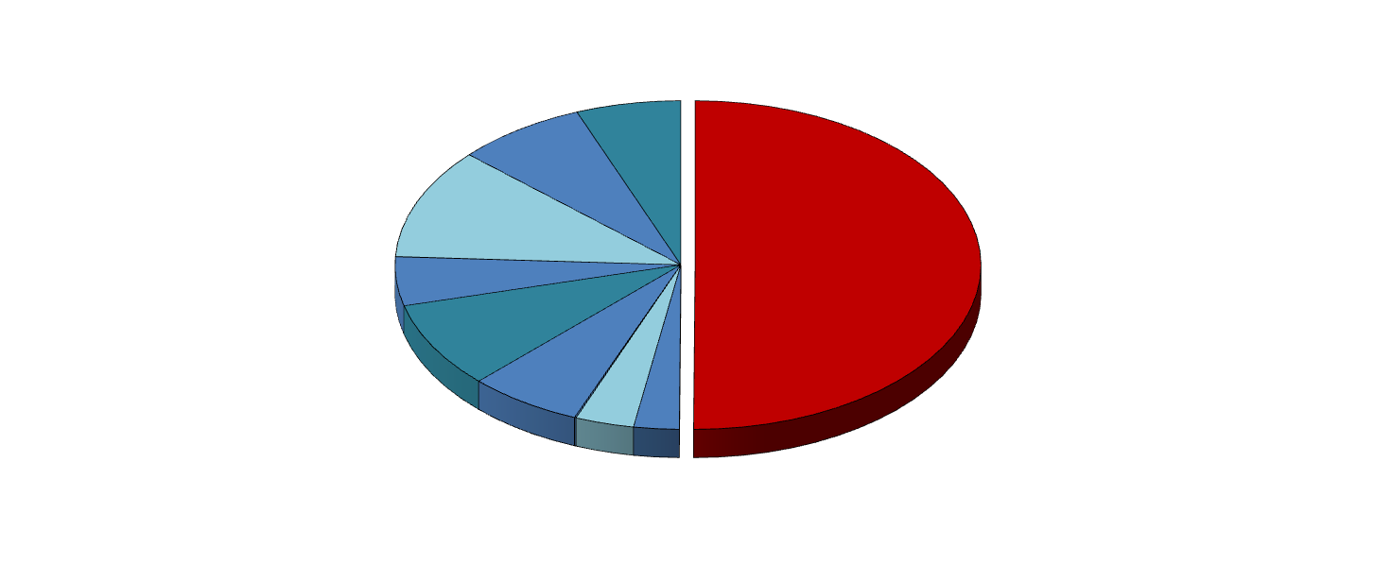
Inpatient Hospital Costs Account for Greatest Proportion of Health Care Expenditures for Patients With Diabetes
Of $116 billion attributed to excess medical expenditures, hospital inpatient days account for ~50% of dollars spent: >$58 billion
Annual Costs Due to Diabetes
(in billions)
Insulin and delivery supplies
$6.91
Oral agents
$8.59
Hospital inpatient
$58.3 billion
Nondiabetes medications
$12.69
Hospice
$0.03
Home health care visits
$5.59
Physician’s office visits
$9.90
Nursing home
$7.49
Ambulance
$0.10
Hospital outpatient
$2.96
Emergency department
$3.87
ADA. Diabetes Care 2008;31:596-615.
Notes:
6

Slide 7
Admission Hyperglycemia Affects
Costs in Acute Ischemic Stroke
656 acute ischemic stroke patients admitted to one
hospital 7/93-6/98
Hyperglycemia present in 40%
  More likely to have prior diagnosis of diabetes
  Most remained hyperglycemic during stay
    Mean BG=206 mg/dL
    43% did not receive inpatient hypoglycemic drugs
Longer length of stay (7 vs 6 days, P=0.015)
30-day mortality risk (HR 1.87, P<0.01)
Higher hospital charges ($6611 vs $5262, P<0.001)
Williams LS, et al. Neurology. 2002;59:67-71.

Slide 8
Level of Glycemia Impacts
Length of Stay (LOS)
Brody School of Medicine , East Carolina University:
1574 CABG patients
Each 50 mg/dL increase in perioperative BG level*
  Added 0.76 days to LOS
  Increased hospital cost by $2824
Portland Diabetic Project: 5510 CABG patients, 1987-2005
Each 50 mg/dL increase in 3-BG** level added 1 day to LOS
  Treatment-induced LOS savings: 1.8 days/patient
  Actual non-OR charge for 1 CABG LOS day = $1150
  Savings from use of intensive insulin protocol, 1.8 x 1150 = $2081
* Perioperative BG = average of day of and day after surgery.
** 3-BG: 3-day average perioperative blood glucose.
Both studies: Levels measured up to >250 mg/dL; lowest level measured <150 mg/dL, no threshold effect specified.
Estrada et al. Ann Thorac Surg. 2003;75:1392-1399; Furnary, et al. Endocr Pract. 2006;12(Suppl 3):22-26.

Slide 9
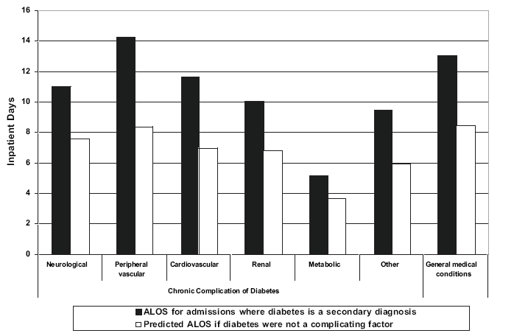
Patients With Comorbid Diabetes Have Longer Lengths of Stay Than When Diabetes Is Not a Complicating Factor
Average hospital length of stay (ALOS) when diabetes is a secondary diagnosis
ADA. Diabetes Care. 2008;31:596-615.

Slide 10
Potentially Preventable Hospitalizations Associated With Uncontrolled Diabetes
Hospitalizations estimated from the NHDS-2004
Hospitalizations estimated from the HCUP-NIS
Uncontrolled diabetes diagnosis (ICD-9-CM code) | Total admissions (95% CI) | Total hospital reimbursement ($ millions) | Total admissions (n) | Total charge ($ millions)
Without complications (250.02-250.03) | 52,798 (43,976-61,620) | 722 | 52,294 | 552
With ketoacidosis (250.10-250.13) | 119,174 (104,485-33,863) | 1372 | 124,510 | 1821
With hyperosmolarity (250.20-250.23) | 14,984 (10,601-19,367) | 201 | 14,572 | 298
With diabetic coma (250.30-250.33) | 4225 (1948-6502) | 84 | 4948 | 164
Total | 191,181 (170,786-211,576) | 2380 | 196,324 | 2836
Kim S. Diabetes Care. 2007;30:1281-1282.

Slide 11
Readmission Rates Higher for
Patients With Diabetes
Rehospitalization Rates
Among 48,612 patients with congestive heart failure from 259 hospitals, 42% had diabetes
All-cause rehospitalization was significantly greater for patients with diabetes than for patients without diabetes (31.5% vs 28.2%; P=0.006)
32%
31.5%
31%
30%
29%
28.2%
28%
27%
26%
No Diabetes
Diabetes
Greenberg BH, et al. Am Heart J. 2007;154:277.e1-8.

Slide 12
Failure to Identify Diabetes Is a
Predictor of Rehospitalization
Readmission Rates
35%
31.0%
30%
25%
20%
15%
10%
9.4%
5%
0%
Diabetes first diagnosed during hospitalization
Diabetes diagnosis missed during hospitalization
Robbins JM, Webb DA. Med Care. 2006;44:292-296.

Slide 13
Opportunity
Identify Patients With
Undiagnosed Diabetes

Slide 14
Increased Identification/Coding of Patients With Diabetes
Diabetes as a First or Second Diagnosis
National average
Olson L, et al. Endocr Pract. 2006;12(suppl 3):35-42.

Slide 15
Increased Revenue From Newly Identified Patients
Diabetes as a Secondary Diagnosis
 | Revenue - Cost | Newly Identified Patients | Increased Margin
FY 97 | $2640
FY98 | $4665 | -28 | -$130,620
FY99 | $3694 | 790 | $2,918,260
FY00 | $4221 | 534 | $2,254,014
FY01 | $4394 | 325 | $1,428,050
FY02 | $5410 | 407 | $2,201,870
FY03 | $4785 | 155 | $741,675
FY04 | $5917 | 128 | $757,376
FY05 | $6233 | 667 | $4,157,411
Total $14,328,036
Olson L, et al. Endocr Pract. 2006;12(suppl 3):35-42.

Slide 16
Opportunity
Reduce the Average Length of Stay (ALOS) Gap Between Patients With and Without Diabetes Through Effective Diabetes Management

Slide 17
After implementing a new hyperglycemia protocol, average blood glucose
levels dropped from 243 mg/dL
to 148 mg/dL
Olson L, et al. Endocr Pract. 2006;12 (suppl 3):35-42.

Slide 18
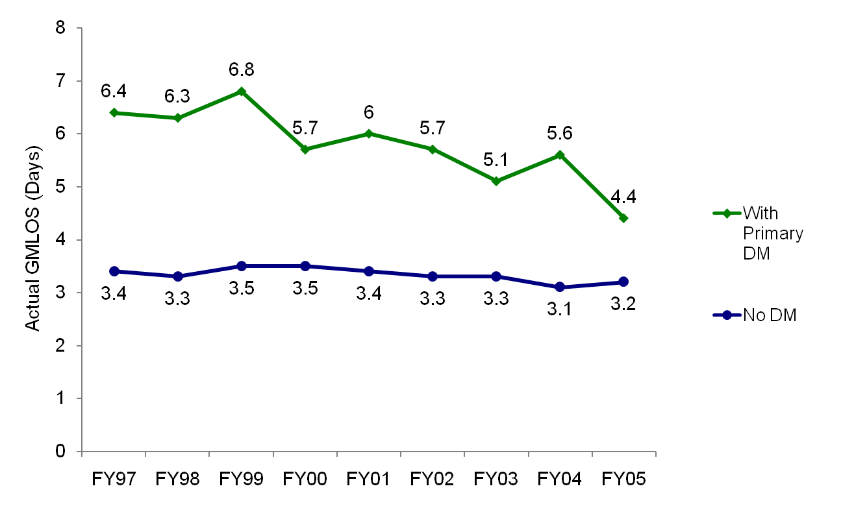
Reducing the ALOS Gap Patients With and Without Diabetes as a First Diagnosis
3.0
1.2
Olson L, et al. Endocr Pract. 2006;12(suppl 3):35-42.

Slide 19
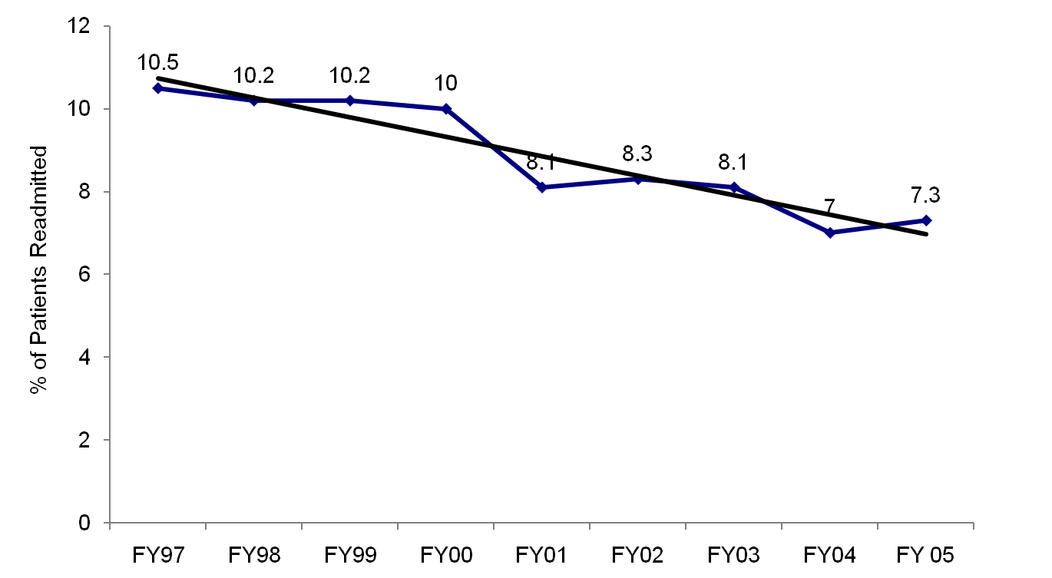
Readmission Trends:
Patients With Diabetes as a Secondary Diagnosis
Olson L, et al. Endocr Pract. 2006;12(suppl 3):35-42.

Slide 20
Implementation of Inpatient Diabetes Management Program Improves the Bottom Line
Accurately identifying and coding patients for diagnosis of diabetes added $632,797 to the bottom line
The gap between average length of stay (ALOS) for patients with diabetes vs those without diabetes was reduced from 3 to 1.2 days
Readmission of patients with diabetes as a second diagnosis decreased from 10.5% to 7.3%
Olson L, et al. Endocr Pract. 2006;12(suppl 3):35-42.
Notes:
20

Slide 21
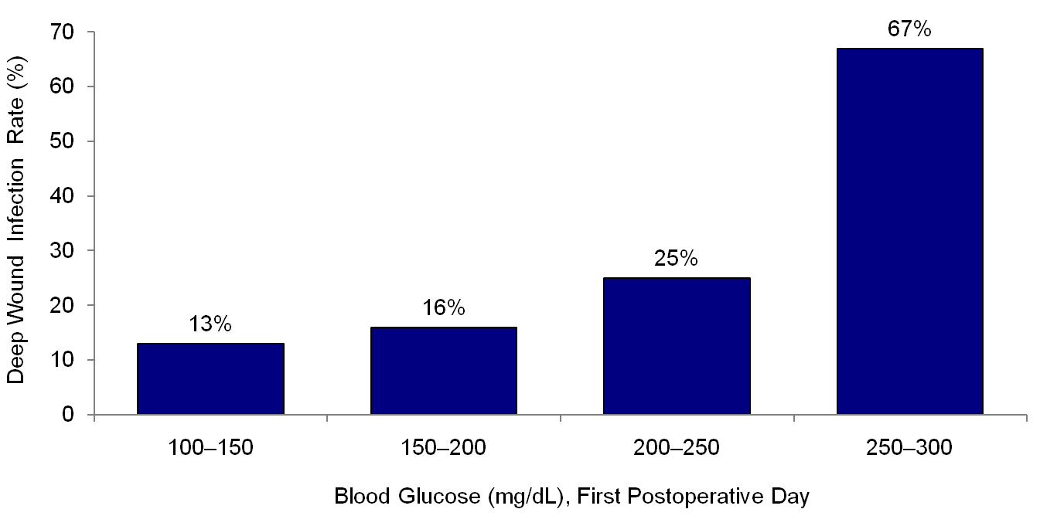
Glucose Control Lowers Risk of Wound Infection in Patients With Diabetes
After Cardiac Surgery
P=0.002
Zerr KJ, et al. Ann Thorac Surg. 1997;63:356-361.

Slide 22
Glucose Control Lowers Costs Associated with Hospital-Acquired Infections
Glucose Monitoring Costs
US Dollars
Reduction in HAI
5%
Cost savings | $262,500
Net benefit | $11,060 | $200,360
10%
Cost savings | $650,000
Net benefit | $398,560 | $587,860
15%
Cost savings | $1,162,500
Net benefit | $911,060 | $1,100,360
HAI, hospital-acquired infection.
Krinsley JS. Hosp Pract (1995). 2014:42:53-58.

Slide 23
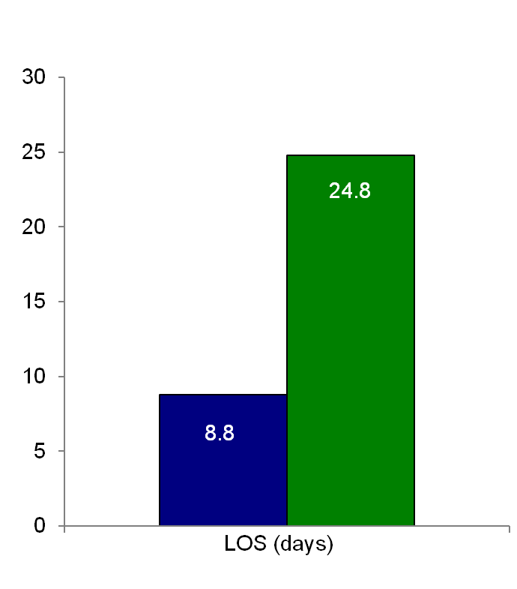
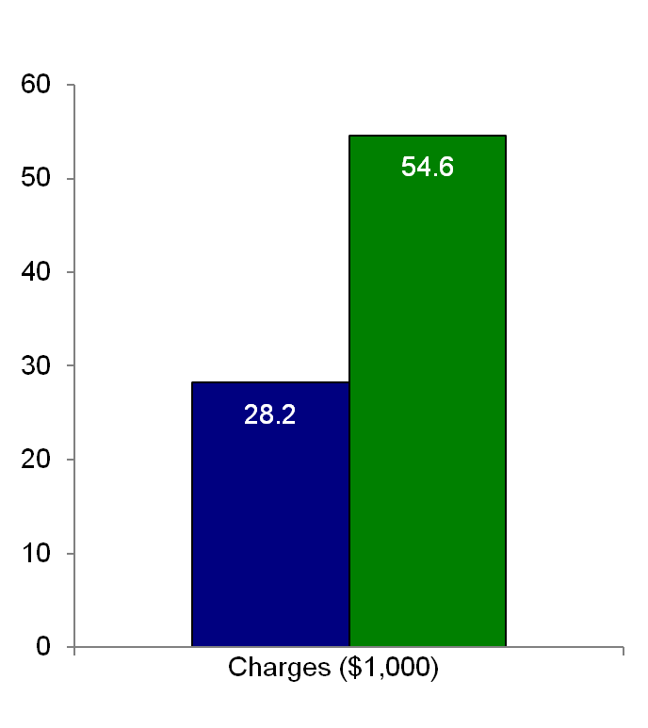
Length of Stay (LOS) and Cost Comparison
Socioeconomic Costs of DSWI: 16 Days and $26,000
■ No DSWI ■ DSWI
Furnary AP, et al. Ann Thorac Surg. 1999;67:352-362.

Slide 24
Use of Intravenous Insulin Therapy
Improves the Bottom Line
In cardiac surgery patients with diabetes, continuous intravenous insulin therapy:
  Reduced risk of deep sternal wound infection (DSWI)
    Per patient cost savings from DSWI prevention = $2613
  Reduced average glucose level by 135 mg/dL, translating into 2.7-day decrease
  in LOS
    Per patient cost savings from glucose reduction = $3105
Total cost savings =
$5580 per patient treated with continuous
intravenous insulin therapy
Furnary AP, et al. Endocr Pract. 2004;10(Suppl 2):21-33.
Notes:
24

Slide 25
Cost Analysis of Glycemic Control in Mixed ICU
Annualized cost savings = $1,340,000
Savings per patient = $1580
Reduced LOS (mean = 3.4 days; median = 1.7 days)
Number of ICU days reduced 17.2%
Number of ventilator hours reduced 19.0%
Laboratory costs reduced 24.3%
Pharmacy costs reduced 16.7%
Imaging costs reduced 5.0%
Krinsley JS, et al. Chest. 2006;129:644-650.

Slide 26
Valuable Results in Clinical and
Financial Outcomes
Changes in the initiation of IV insulin therapy have reduced monthly average glucose values in the medical ICU from 169 to 123 mg/dL
The rate of catheter-related bloodstream infection (CR-BSI) has been reduced 33.5%
Reducing these infections is estimated to save $6198 per 1000 event days, more than offsetting the additional cost of the IV insulin
Newton C, et al. Endocr Pract. 2006;12(suppl 3):43-48.

Slide 27
Implementation of Inpatient Diabetes Management Program Improves the Bottom Line
Implementing an inpatient diabetes management program was associated with a length of stay reduction of 0.26 days, resulting in:
  Revenue enhancement of $2,224,029 due to increased throughput
  Return on investment of 467%
Rate of catheter-related bloodstream infection was reduced by one-third in cardiac surgery patients, resulting in:
  Estimated saving of $6198 per 1000 event days
Newton C, et al. Endocr Pract. 2006;12(suppl 3):43-48.
Notes:
27

Slide 28
The ALOS for Patients With a Diagnosis of Diabetes Decreased From 6.01 to 5.75
Benefits include:
  Cost aversion
    Particularly relevant for patients who have a predetermined reimbursement based on DRG
  Throughput
    Appropriately discharging a patient more quickly makes the bed available to another patient
    Multiplying an incremental inpatient volume by the revenue margin per patient totaled a throughput value of more than
    $2 million/year
Newton C, et al. Endocr Pract. 2006;12(suppl 3):43-48.

Slide 29
Economic Benefits of Intensive
Insulin Therapy in the ICU
Targeted Insulin Therapy to Improve Hospital Outcomes
Multidisciplinary approach to develop new insulin protocols and educate physicians, nurses, pharmacists, dietitians
IV insulin protocol modified version of Markovitz protocol initiated for BG >140mg/dL
Subcutaneous insulin incorporating basal, nutritional, and corrective insulin
Core TRIUMPH team consisting of endocrinologist and diabetes educator would oversee management
Sadhu AR, et al. Diabetes Care. 2008;31:1556-1561.

Slide 30
Economic Analysis of Intensive Insulin Therapy in Critically Ill: TRIUMPH Study
Economic impact of implementation of a clinical glucose management service in the ICUs
Difference analysis:
  Change in a given outcome between intervention vs comparison groups over the pre- and post-intervention periods
  Accounted for any confounding secular time trends over the years (eg, price inflation, hospital-wide financial changes, and other new clinical practices)
Sadhu A, et al. Diabetes Care. 2008;31(8):1556-1661.

Slide 31
Types of Hospitalization Costs
Direct | Patient care expenses Examples: nursing, radiology, pharmacy, laboratory
Indirect | Ancillary care expenses Examples: patient escort, nutrition, administration, financial services
Variable | Costs that change with volume
Fixed | Do not change with volume Example: cost of building space
Total | All above costs together
Sadhu A, et al. Diabetes Care. 2008;31(8):1556-1661.

Slide 32
TRIUMPH Study: Cost Analysis
After 1 Year
Outcome | Change in Outcome N=6719 2003-2005
Total costs | -$4746 (-$10,509, $1832)
Direct variable costs | -$2210 (-$5593, $1584)
Total ICU costs | -$5231 (-$13,775, $3591)
Direct variable ICU costs | -$1143 (-$4096, $2068)
Total hospital LOS | -0.47 (-1.87, 1.02)
ICU LOS | -1.19 (-1.93, -0.43)*
Mortality | -.011 (-0.05, 0.03)
* P≤0.05.
Sadhu A, et al. Diabetes Care. 2008;31(8):1556-1661.

Slide 33
TRIUMPH Study: Cost Analysis
After 3 Years
Outcome | Change in Outcome N=11,129 (2003-2007)**
Total costs | -$7580 (-$13,643, -$1180)*
Direct variable costs | -$4960 (-$8998, -$850)*
Total ICU costs | -$9919(-$17,995, -$2175)*
Direct variable ICU costs | -$3216 (-$6219, -$371)*
Total days | -0.25 (-1.55, .99)
ICU days | -1.88 (-2.78, -0.89)*
Mortality | -.026 (-.06,.00006)
Average glucose per patient day (mg/dL) | -9.18 (-12.49, -5.97)**
* P≤.05.
** Glucose readings are from 2004 to 2007.
Costs are CPI adjusted; 95% empirical, bias-corrected bootstrapped confidence intervals shown in parentheses.
Sadhu A, et al. Diabetes. 2010;59(Supp 1):Abstr. 433-PP.

Slide 34
Bottom Line
3381 admissions treated under the TRIUMPH program from 2005-2007
Total cost savings of $7580/patient
$25,627,980
Sadhu A, et al. Diabetes. 2010;59(Supp 1):Abstr. 433-PP.

Slide 35
Economic and Clinical Impact of Hypoglycemia

Slide 36
LOS and Hypoglycemia
2538 patients treated with IIT after cardiac surgery¹
  77 patients with hypoglycemia (≤3.3 mmol/L or 60 mg/dL) had:
    Increased ICU LOS by 3 days (P<0.001)
    Increased hospital LOS by 11 days (P<0.001)
4368 admissions of patients with diabetes²
  Increase in LOS of 2.5 days for each additional day with hypoglycemia (≤2.5 mmol/L or 50 mg/dL)
  Difference between actual LOS and expected LOS was 8.8 days for patients with >2 days with hypoglycemia
1. Stamou SC, et al. J Thorac Cardiovasc Surg . 2011;142:166-173.
2. Turchin A, et al. Diabetes Care. 2009;32:1153-1157.

Slide 37
Impact of Hypoglycemia
During Hospitalization
Outcome | Patients with hypoglycemia Mean (median) | Patients without hypoglycemia Mean (median) | Comparison
 |  |  | Difference/OR (95% CI) | P value
Total Charges (2006 $) BG <70 mg/dL BG <50 mg/dL | 85,905 (33,446) 98,304 (25,401) | 54,038 (17,609) | 39% (36-42) 50% (43-55) | <0.001 <0.001
Length of stay (days) BG <70 mg/dL BG <50 mg/dL | 11.7 (8.0) 13.6 (9.1) | 5.1 (3.8) | 3.0 (2.8-3.2) 4.2 (3.8-4.6) | <0.001 <0.001
Hospital mortality (%) BG <70 mg/dL BG <50 mg/dL | 4.8% 6.3% | 2.3% | 1.07 (1.02-1.11) 1.16 (1.09-1.30) | 0.007 <0.001
New discharge to SNF BG <70 mg/dL BG <50 mg/dL | 26.5% 22.7% | 14.5% | 1.58 (1.48-1.69) 1.84 (1.65-2.04) | <0.001 <0.001
Curkendall SM, et al. Endocr Pract. 2009;15:302-312.

Slide 38
Key Points
Diabetes is an increasingly prevalent diagnosis among hospitalized patients
  Many patients have unrecognized diabetes
Diabetes contributes to greater lengths of stay and increased costs among hospitalized patients
Identifying and treating diabetes:
  Reduces risk of serious and expensive complications
  Reduces length of stay
  Improves the bottom line
Notes:
38

Slide 39
Key Points
Hospitals and physicians who are diabetes experts, with the support of other allied health professionals, can work together to:
  Enhance the quality of care and improve outcomes
  Increase revenues with appropriate payment for care provided and resources expended
Proactive implementation of programs to improve diabetes control
improves both patient outcome and hospital bottom lines.

Slide 40
Conclusion
Glycemic control in the hospital should become a priority
  Enhance quality and patient safety
  Competitive advantage
  Cost savings
  The Joint Commission Certification

