Slide 1
Clinical Evidence for Glucose Control in the Inpatient Setting

Slide 2
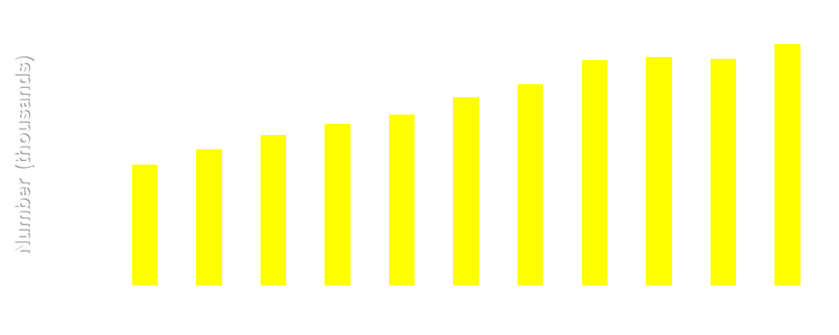
Number of US Hospital Discharges with Diabetes as Any-Listed Diagnosis
Centers for Disease Control and Prevention. Diabetes Data and Trends. Available at: http://www.cdc.gov/diabetes/statistics/dmany/fig1.htm.
Notes:
2

Slide 3
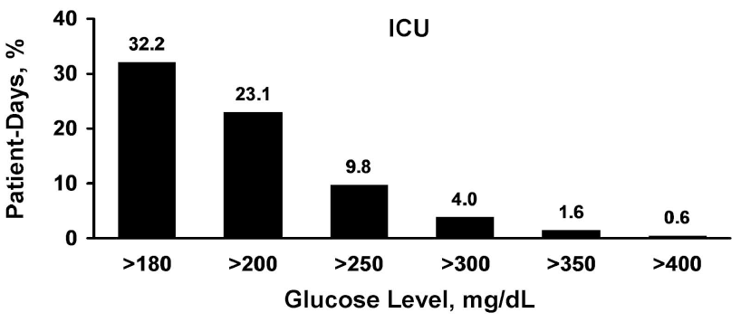
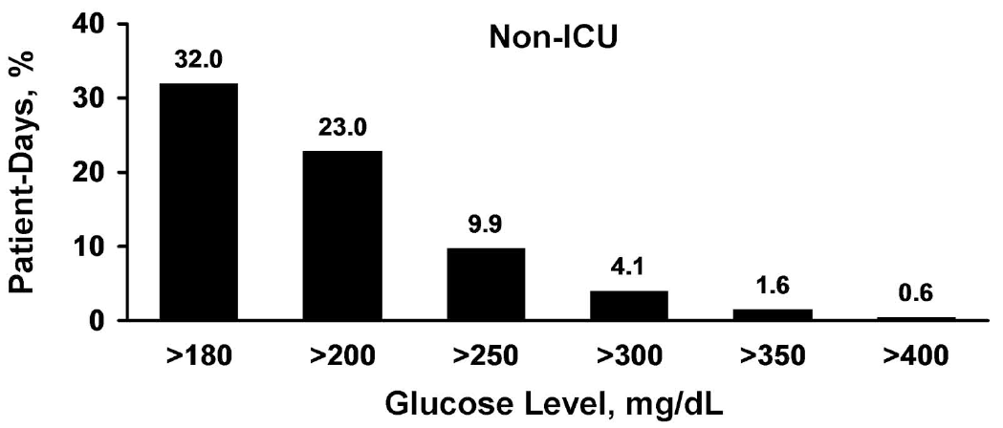
Distribution of Patient-Day-Weighted Mean POC-BG Values for ICU
~12 million BG readings from 653,359 ICU patients; mean POC-BG: 167 mg/dL.
Swanson CM, et al. Endocr Pract. 2011;17:853-861.

Slide 4
Prevalence of Hyperglycemia in Critically Ill Patients
Prospective Observational Study
(N=1000)
Patients (%)
CIAH, critical illness associated hyperglycemia.
Plummer MP, et al. Intensive Care Med. 2014;40:973-980.

Slide 5
Hyperglycemia and Mortality in the Medical Intensive Care Unit
~4x
45
~3x
45
45
40
40
40
35
~2x
35
35
30
30
30
25
25
25
Mortality Rate (%)
20
20
20
15
15
15
10
10
10
5
5
5
0
0
0
80-99
100-119
120-139
140-159
160-179
180-199
200-249
250-299
>300
Mean Glucose Value (mg/dL)
N=1826 ICU patients.
Krinsley JS. Mayo Clin Proc. 2003;78:1471-1478.

Slide 6
Mortality Increases With Increases in Average BG Levels
Post-CABG
16
14
Cardiac-related mortality
Noncardiac-related mortality
12
10
Mortality %
8
6
4
2
0
<150
150–175
175–200
200–225
225–250
>250
Average Postoperative Glucose (mg/dL)
CABG, coronary artery bypass graft.
Furnary AP et al. J Thorac Cardiovasc Surg. 2003;125:1007-1021.
Notes:
6

Slide 7
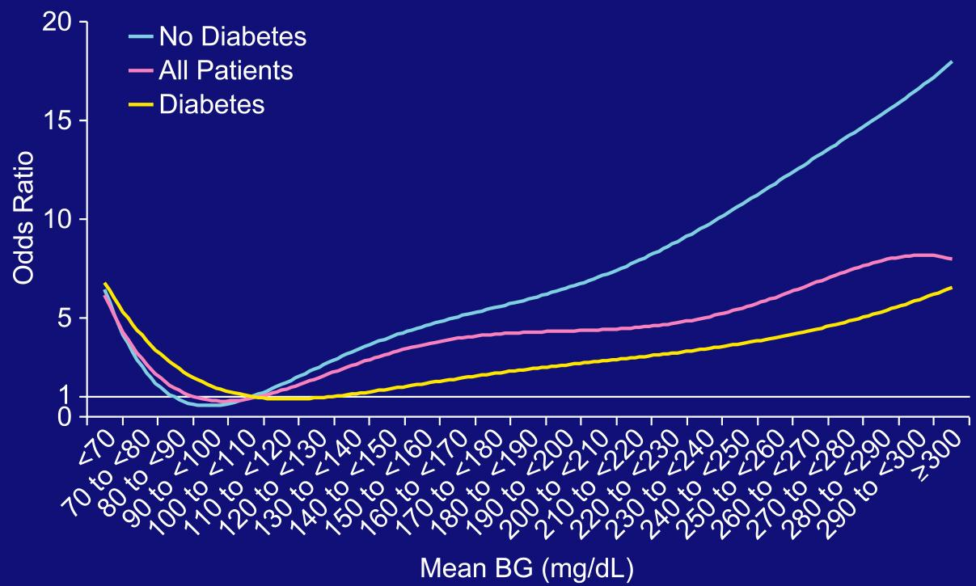
Mean Glucose and In-Hospital Mortality in 16,871 Patients With Acute MI
(Reference: Mean BG 100-110 mg/dL)
Kosiborod M, et al. Circulation. 2008:117:1018-1027.

Slide 8
Hyperglycemia and Mortality in
259,040 Critically Ill Patients
216,775 consecutive first admissions
173 surgical, medical, cardiac ICUs
73 geographically diverse VAMC 9/02–3/05
Severity of illness
Mean glucose
Hospital mortality
Falciglia M, et al. Crit Care Med. 2009;37:3001-3009.
Notes:
8

Slide 9
Hyperglycemia Is Associated With Increased Risk-Adjusted Mortality
Total Population 216,775
> 300
200 – 300
Mean BG (mg/dL)
146 – 199
111 – 145
0 1 2 3 4 5
Adjusted Odds Ratio
Falciglia M, et al. Crit Care Med. 2009;37:3001-3009.
Notes:
9

Slide 10


Mortality Risk Is Greater in Hyperglycemic Patients Without History of Diabetes
No History Diabetes,
N=152,910
History Diabetes,
N= 62,868
>300
200-300
Mean BG (mg/dL)
146-199
111-145
Odds Ratio
Odds Ratio
Falciglia M, et al. Crit Care Med. 2009;37:3001-3009.
Notes:
10

Slide 11
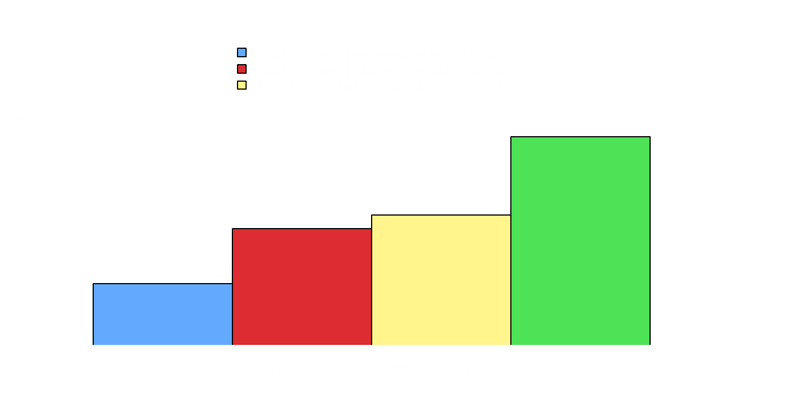
Hyperglycemia Is Linked to Mortality Regardless of Diabetes Status
*
*
* ≥200 mg/dL.
Rady MY, et al. Mayo Clin Proc. 2005;80:1558-1567.
Ainla MIT, et al. Diabet Med. 2005;22:1321-1325.
Notes:
11

Slide 12
Hyperglycemia During TPN Is Associated
With Greater Risk of Hospital Mortality
45
BG within 24 hours of TPN
BG during TPN (days 2-10)
40
35
30
25
20
15
10
5
0
≤120
121-150
151-180
>180
Blood Glucose
Pasquel FJ, et al. Diabetes Care. 2010;33:739-741.
Mortality (%)

Slide 13

Mortality in Inpatients With
“New Hyperglycemia”
P <.01
P <.01
In-hospital Mortality Rate (%)
Patients
With Normoglycemia
Patients
With History
of Diabetes
Newly
Discovered Hyperglycemia
Umpierrez GE, et al. J Clin Endocrinol Metab. 2002;87:978-982.

Slide 14
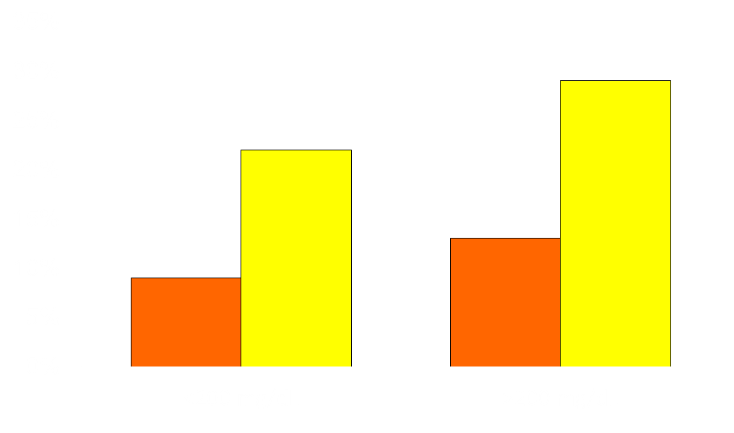
Admission Hyperglycemia Is Also Associated With Adverse Outcomes in Non-ICU Settings
Mortality
Complications‡
†
†
N=2471
Non-ICU patients with community-acquired pneumonia
Patients
*
*
Admission BG Level
* P=0.03; †P=0.01.
‡ Complications include all in-hospital complications except for abnormalities of glucose.
McAlister FA, et al. Diabetes Care. 2005;28:810-815.

Slide 15
Outcomes Associated With Glycemic Control in the Hospital
Notes:
15

Slide 16
Association Between Mortality and Time in Target Blood Glucose Range
Retrospective Study, 2009-2013
(N=3297)
P<0.0001
P=0.5994
Mortality (%)
Median TIR
80.6% (IQR 61.4%-94.0%)
Median TIR
55.0% (IQR 35.3%-71.1%)
IQR, interquartile range; TIR, time in range; TIR-high, time in targeted blood glucose range above median value for cohort; TIR-low, time in targeted blood glucose range below median value for cohort.
Krinsley JS, Preiser J-C. Crit Care. 2015;19:179.

Slide 17
Benefits of Tight Glycemic Control: Observational Studies and Early
Intervention Trials
Study | Setting | Population | Clinical Outcome
Furnary, 1999 | ICU | DM undergoing open heart surgery | 65% ↓ infection
Furnary, 2003 | ICU | DM undergoing CABG | 57% ↓ mortality
Krinsley, 2004 | Medical/surgical ICU | Mixed, no Cardiac | 29% ↓ mortality
Malmberg, 1995 | CCU | Mixed | 28% ↓ mortality After 1 year
Van den Berghe, 2001* | Surgical ICU | Mixed, with CABG | 42% ↓ mortality
Lazar, 2004 | OR and ICU | CABG and DM | 60% ↓ A Fib post op survival 2 year
Kitabchi AE, et al. Metabolism. 2008;57:116-120.

Slide 18
Portland Diabetic Project
Incidence of DSWI and Impact of Implementation of Insulin Infusion Protocols; 1987-1997
4.0
CII
3.0
Patients with diabetes
2.0
DSWI (%)
Patients without diabetes
1.0
0.0
87
88
89
90
91
92
93
94
95
96
97
Year
DSWI, deep sternal wound infection; CII, continuous insulin infusion.
Furnary AP, et al. Ann Thorac Surg. 1999;67:352-362.

Slide 19
Glucose Control With IV Insulin Lowers Mortality Risk After Cardiac Surgery
10
IV Insulin Protocol
8
Patients with diabetes
6
Patients without diabetes
Mortality (%)
4
2
0
87
88
89
90
91
92
93
94
95
96
97
98
99
00
01
Year
Furnary AP, et al. J Thorac Cardiovasc Surg. 2003;125:1007-1021.

Slide 20


Intensive Insulin Management in Medical-Surgical ICU
P <0.001
P <0.002
29.3% Reduction
Mean BG Levels
(mg/dL)
Hospital Mortality (%)
Baseline group (n=800)
Glucose management group (n=800)
Krinsley JS. Mayo Clin Proc. 2004;79:992-1000.

Slide 21
Intensive Insulin Therapy in Critically Ill Patients: The Leuven SICU Study
Randomized controlled trial
  1548 patients admitted to a surgical ICU, receiving mechanical ventilation
Patients assigned to receive either:
  Conventional therapy: IV insulin only if BG >215 mg/dL
    Target BG levels: 180-200 mg/dL
    Mean daily BG: 153 mg/dL
  Intensive therapy: IV insulin if BG >110 mg/dL
    Target BG levels: 80-110 mg/dL
    Mean daily BG: 103 mg/dL
Van den Berghe G, et al. N Engl J Med. 2001;345:1359-1367.

Slide 22
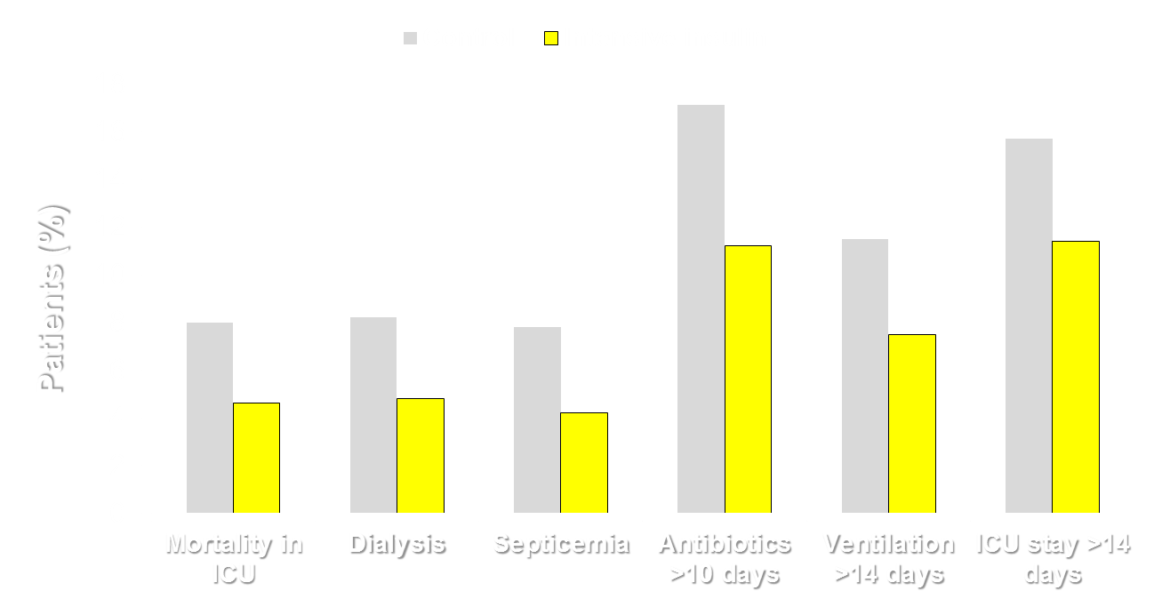
Intensive Insulin Therapy in Critically
Ill Patients: SICU
P<0.001
P=0.01
P=0.003
P<0.04
P=0.007
P=0.003
Van den Berghe G, et al. N Engl J Med. 2001;345:1359-1367.

Slide 23
RCTs of Inpatient Glucose Management
Trial | N | Setting | Primary Outcome | Odds Ratio (95% CI) | P value
Van den Berghe 2006 | 1200 | MICU | Hospital mortality | 0.94 (0.84-1.06) | N.S.
HI-5 2006 | 240 | CCU AMI | 6-mo mortality | NR | N.S.
Glucontrol 2007 | 1101 | ICU | ICU mortality | 1.10 (0.84-1.44) | N.S.
VISEP 2008 | 537 | ICU | 28-d mortality | 0.89 (0.58-1.38) | N.S.
De La Rosa 2008 | 504 | SICU MICU | 28-d mortality | NR | N.S.
NICE-SUGAR 2009 | 6104 | ICU | 3-mo mortality | 1.14 (1.02-1.28) | <0.05
Rabbit 2 Surgery 2011 | 211 | SICU | Composite of postop outcomes | 3.39 (1.50-7.65) | 0.003

Slide 24
Intensive Insulin Therapy in the Medical Intensive Care Unit: The Leuven Study
Randomized controlled trial
  1200 patients admitted to a medical ICU
Patients assigned to receive either:
  Conventional therapy: IV insulin if BG >215 mg/dL
    Target BG levels: 180-200 mg/dL
    Mean daily BG: 153 mg/dL
  Intensive therapy: IV insulin if BG >110 mg/dL
    Target BG levels: 80-110 mg/dL
    Mean daily BG: 111 mg/dL
Van Den Berghe G, et al. N Engl J Med. 2006;354:449-461.
Notes:
24

Slide 25
Intensive Insulin Therapy in MICU:
Hospital Mortality
Conventional treatment
Intensive treatment
Intention to Treat
ICU LOS ≥3 Days
P=0.33
P=0.009
40
52.5
37.3
P=0.05
P=0.31
43.0
26.8
38.1
24.2
31.3
Patients (%)
Patients (%)
ICU Mortality
Hospital Mortality
ICU Mortality
Hospital Mortality
Hazard ratio 0.94 (95% CI 0.84-1.06)
Mortality
Reduction
17.9%
Mortality
Reduction
18.1%
Van Den Berghe G, et al. N Engl J Med. 2006;354:449-461.

Slide 26
Intensive Insulin Therapy in MICU:
Hypoglycemia
Conventional Intensive
(605) (595)
Hypoglycemia events # (%) 19 (3.1) 111 (18.7)
Two or more episodes 5 (0.8) 23 (3.9)
Glucose level (mg/dL) 31 ± 8 32 ± 5
Identified hypoglycemia as an “independent risk factor for death”
Van Den Berghe G, et al. N Engl J Med. 2006;354:449-461.
Notes:
26

Slide 27
Glucontrol Trial
Compare the effects of 2 regimens of insulin therapy on clinical outcome:
  Intensive therapy group:
    Target BG: 80-110 mg/dL
    Achieved mean BG: 118 mg/dL (109-131 mg/dL)
  Conventional therapy group:
    Target BG: 140-180 mg/dL
    Achieved mean BG: 147 mg/dL (127-163 mg/dL)
  Nondiabetic patients: 872
  Diabetic patients: 210
Preiser JC, et al. Intensive Care Med. 2009;35:1738-1748.

Slide 28
Glucontrol Trial
 | Intensive Insulin Therapy (n=536) | Conventional Insulin Therapy (n=546) | P
Nondiabetic patients 872 patients Deaths | 446 17.0% | 426 16.2% | 0.738
Diabetic patients 210 patients Deaths | 90 16.7% | 120 11.7% | 0.298
Preiser JC, et al. Intensive Care Med. 2009;35:1738-1748.
Notes:
28

Slide 29
Glucontrol Trial
 | Intensive Insulin Therapy (n=536) | Conventional Insulin Therapy (n=546) | P
Mortality rate, % | 16.97 | 15.20 | 0.465
Patients with hypoglycemia,* % | 8.6 | 2.4 | <0.0001
Death among patients with hypoglycemia,* % | 32.6 | 53.8 | 0.1621
* Blood glucose <40 mg/dL.
Preiser JC, et al. Intensive Care Med. 2009;35:1738-1748.
Notes:
29

Slide 30
VISEP Trial
Study aim: evaluate clinical outcome in 600 subjects with sepsis randomized to conventional or intensive insulin therapy in 18 academic hospitals in Germany
  Conventional therapy: Continuous insulin infusion (CII) started at BG >200 mg/dL and adjusted to maintain a BG 180-200 mg/dL (mean BG 151 mg/dL)
  Intensive therapy: CII started at BG >110 mg/dL and adjusted to maintain BG 80-110 mg/dL (mean BG 112 mg/dL)
Primary outcomes
  Mortality (28 days) and morbidity (sequential organ failure dysfunction, SOFA)
  Safety end-point: hypoglycemia (BG <40 mg/dL)
Brunkhorst FM, et al. N Engl J Med. 2008:358:125-139.

Slide 31
VISEP Trial
Blood Glucose
Overall Survival
No difference in mortality
100
90
Conventional therapy (n=290)
200
80
70
150
60
Probability of Survival (%)
Intensive therapy (n=247)
50
Mean Blood Glucose (mg/dL)
40
100
30
50
Conventional therapy
20
Intensive therapy
10
0
0
0
1
2
3
4
5
6
7
8
9
10
11
12
13
14
0
10
20
30
40
50
60
70
80
90
100
Days
Days
Data from 537 patients:
247 received IIT goal: 80-110 mg/dL: mean BG 112 mg/dL
290 received CIT goal: 180-200 mg/dL: mean BG 151 mg/dL
IIT, intensive insulin therapy; CIT, conventional insulin therapy.
Brunkhorst FM, et al. N Engl J Med. 2008:358:125-139.

Slide 32
VISEP Trial
 | Intensive Insulin Therapy (n=247) | Conventional Insulin Therapy (n=290) | P
Mortality rate, % 28 days 90 days | 24.7 39.7 | 26.0 35.4 | 0.74 0.31
Patients with hypoglycemia,* % | 17.0% | 4.1% | <0.001
SOFA score (mean) 95% CI | 7.8 7.3-8.3 | 7.7 7.3-8.2 | 0.16
* Blood glucose ≤40 mg/dL.
Brunkhorst FM, et al. N Engl J Med. 2008:358:125-139.

Slide 33
Intensive Insulin Therapy in Severe Sepsis and Severe Hypoglycemia
(VISEP Study)
 | Conventional Insulin Therapy (n=290) | Intensive Insulin Therapy (n=247)
 | (Glucose ≤40 mg/dL)
# of patients with hypo events | 12 | 42
% of patients with hypo events | 4.1 | 17.0
% of patients with life-threatening hypo events | 2.1 | 5.3
Hypoglycemia identified as an independent risk factor for mortality*
* Personal communication, Dr. Frank Brunkhorst
Brunkhorst FM, et al. N Engl J Med. 2008:358:125-139.
Notes:
33

Slide 34
Intensive Glycemic Control in a Mixed ICU
 | Intensive (n=254) | Standard (n=250)
Mean AM glucose, mg/dL | 117 | 148
28-day mortality, n (%) | 93 (36.6) | 81 (32.4)
In-hospital mortality, n (%) | 102 (40) | 96 (38.4)
Severe hypoglycemia (≤40 mg/dL), n (%) | 21 (8.3) | 2 (0.8)
504 patients; ~1/2 medical; single-center study from Colombia
De La Rosa Gdel C, et al. Crit Care. 2008;12:R120.
Notes:
34

Slide 35
NICE-SUGAR Study
Multicenter-multinational randomized, controlled trial (Australia, New Zealand, and Canada; N=6104 ICU patients)
  Intensive BG target: 4.5-6.0 mmol/L (81-108 mg/dL)
  Conventional BG target: <10.0 mmol/L (180 mg/dL)
Primary outcome: Death from any cause within 90 days after randomization
Patient population
  Mean APACHE II score: ~21; APACHE >25: 31%
  Reason for ICU admission: surgery: ~37%, medical: 63%
  History of DM: 20% (T1DM: 8%, T2DM: 92%)
  At randomization: sepsis: 22%, trauma: 15%
Finfer S, et al. N Engl J Med. 2009;360:1283-1297.

Slide 36
NICE-SUGAR: Baseline Characteristics
Age: ~60 years
Gender: ~36% female
Diabetes: ~20% (BMI ~28 kg/m²)
Interval, ICU admission to randomization: 13.4 h
Reason for ICU admission:
  Operative* ~37%
  Non-operative† ~63%
Sepsis: ~22%
Trauma: ~15%
* No significant numbers of CT surgery patients.
† No significant numbers of CCU patients.
Finfer S, et al. N Engl J Med. 2009;360:1283-1297.
Notes:
36

Slide 37
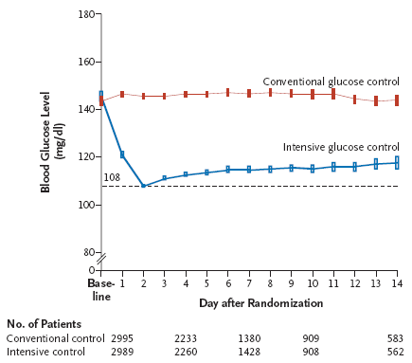
NICE-SUGAR: Intensive vs Conventional Glucose Control in Critically Ill Patients
Bars are 95% confidence intervals. Dashed line =108 mg/dL (upper limit of intensive glucose control target range).
Finfer S, et al. N Engl J Med. 2009;360:1283-1297.
Notes:
37
37

Slide 38
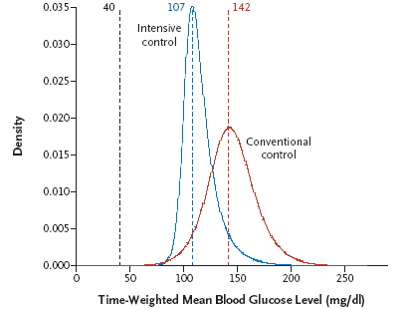
NICE-SUGAR: Intensive vs Conventional Glucose Control in Critically Ill Patients
Density Plot for Mean Time-Weighted Blood Glucose Levels for Individual Patients
The dashed lines indicate the modes (most frequent values) in the intensive control group (blue) and the conventional-control group (red), as well as the upper threshold for severe hypoglycemia (black).
Finfer S, et al. N Engl J Med. 2009;360:1283-1297.
Notes:
38
38

Slide 39
NICE-SUGAR Study Outcomes
Outcome Measure | Intensive Group | Conventional Group
Morning BG (mg/dL) | 118 + 25 | 145 + 26
Hypoglycemia (≤40mg/dL) | 206/3016 (6.8%) | 15/3014 (0.5%)
28-Day Mortality (P=0.17) | 22.3% | 20.8%
90-Day Mortality (P=0.02) | 27.5% | 24.9%
Finfer S, et al. N Engl J Med. 2009;360:1283-1297.

Slide 40
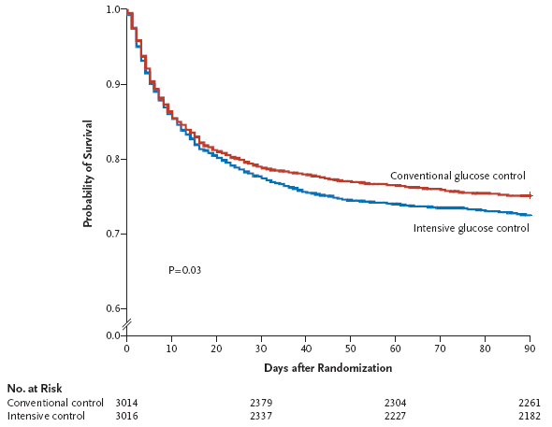
NICE-SUGAR: Intensive vs Conventional Glucose Control in Critically Ill Patients
Kaplan–Meier Estimates for the Probability of Survival
% HR = 1.11
95 confidence interval:
(1.01-1.23)
Finfer S, et al. N Engl J Med. 2009;360:1283-1297.
Notes:
40
40

Slide 41
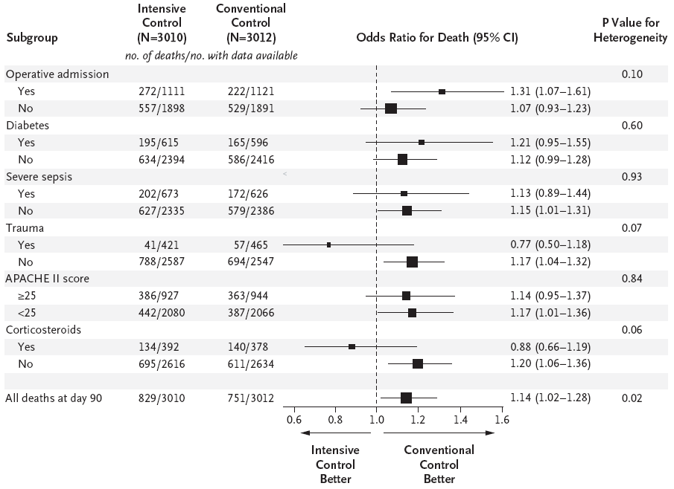
NICE-SUGAR: Probability of Survival and Odds
Ratios for Death, According to Treatment Group
Finfer S, et al. N Engl J Med. 2009;360:1283-1297.

Slide 42
NICE-SUGAR: Conclusions
This large, international, randomized trial found that intensive glucose control did not offer any benefit in critically ill patients
Blood glucose target of <180 mg/dL with the achieved target of 144 mg/dL resulted in lower (90-day) mortality than did a target of 81-108 mg/dL
There was increased hypoglycemia with lower glucose targets
Finfer S, et al. N Engl J Med. 2009;360:1283-1297.

Slide 43
NICE-SUGAR: Strengths
Large (N=6104)
Multicenter
Patients characteristic of a general ICU population
Uniformly applied, web-based IV insulin protocol
Hard primary endpoint (90-day mortality)
Robust analytical plan
Finfer S, et al. N Engl J Med. 2009;360:1283-1297.
Notes:
43

Slide 44
NICE-SUGAR: Limitations
Specified BG targets and ultimate BG separation
(-27 mg/dL) not as distinct as prior trials
Treatment target not achieved in the intensive arm
Variable methods/sources for BG measurement
More steroid therapy in intensive arm
More hypoglycemia in intensive arm (15-fold)
No explanation of increased mortality in intensive arm (? hypoglycemia)
~10% early withdrawals in intensive arm; “per-protocol” (“completers”) analysis not provided
Finfer S, et al. N Engl J Med. 2009;360:1283-1297.
Notes:
44

Slide 45
Tight Glycemic Control in Critically Ill Adults
A Meta-analysis of 29 Randomized Controlled Trials
Very tight, moderately tight glycemia control and severe hypoglycemia
Wiener RS, et al. JAMA. 2008:300:933-944.
Notes:
45

Slide 46
Tight Glycemic Control in Critically Ill Adults
A Meta-analysis of 29 Randomized Controlled Trials
SICU, MICU, mixed ICU, and severe hypoglycemia
Wiener RS, et al. JAMA. 2008:300:933-944.
Notes:
46

Slide 47
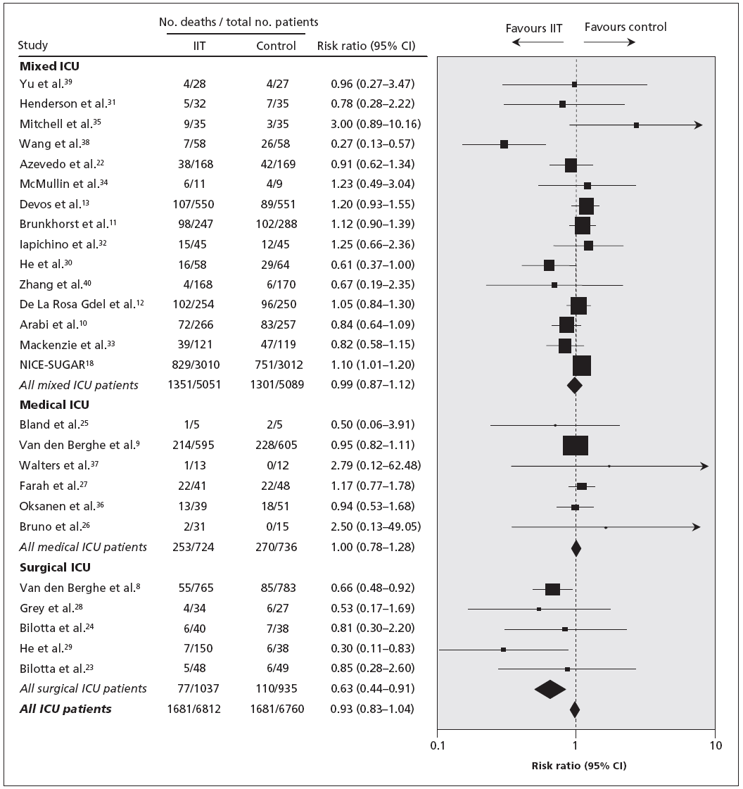
Meta-analysis:
Intensive Insulin Therapy and Mortality
Griesdale DE, et al. CMAJ. 2009;180:821-827.

Slide 48
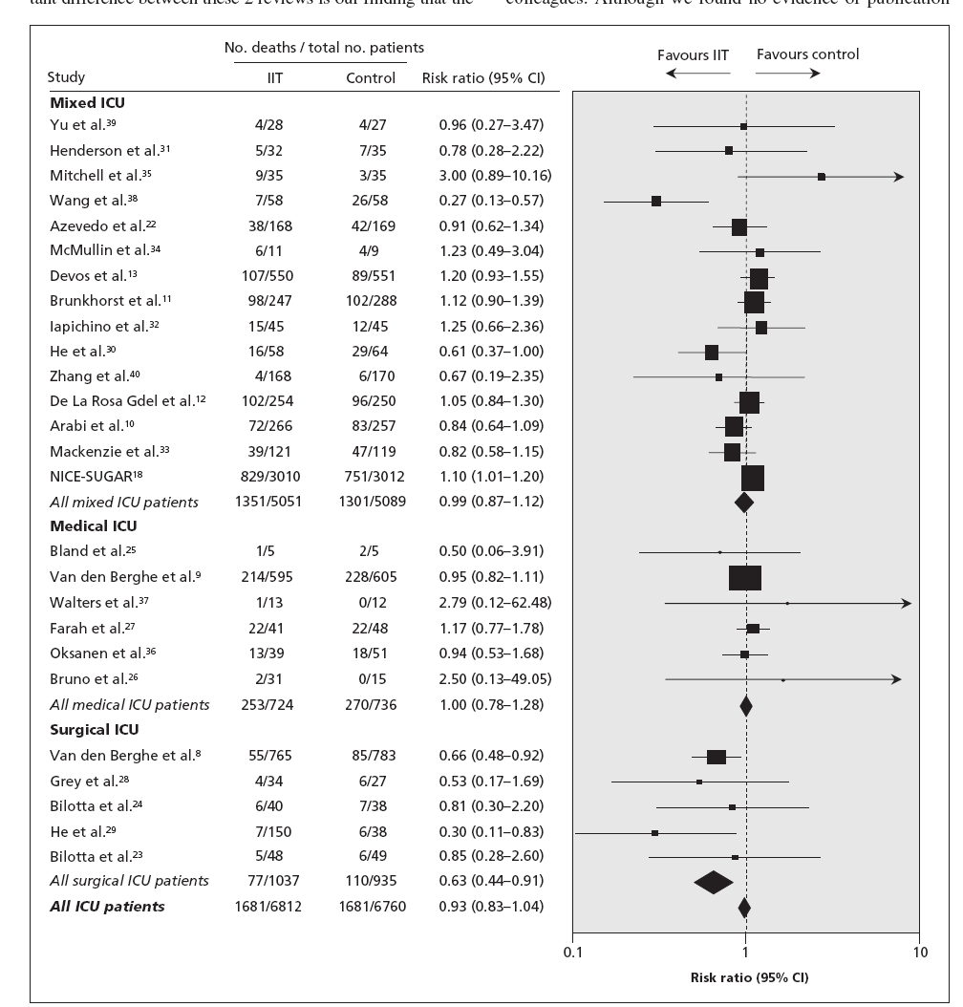
Tight Glycemic Control in Critically Ill Adults
A Meta-analysis of 26 Randomized Controlled Trials
(13,567 patients)
All-Cause
Mortality
Mixed ICU
Griesdale DE, et al. CMAJ. 2009;180:821-827.
Notes:
48

Slide 49
Tight Glycemic Control in Critically Ill Adults
A Meta-analysis of 26 Randomized Controlled Trials
(13,567 patients)
Severe
Hypoglycemia
(≤40 mg/dL)
Griesdale DE, et al. CMAJ. 2009;180:821-827.
Notes:
49

Slide 50
Rabbit 2 Trial: Changes in Glucose Levels With Basal-Bolus vs Sliding Scale Insulin
240
220
*
*
200
*
*
*
*
180
*
BG (mg/dL)
Sliding scale
160
140
Basal bolus
120
100
Admit
1
2
3
4
5
6
7
8
9
10
Days of Therapy
* P<0.05.
Sliding scale regular insulin (SSRI): given 4 times daily.
Basal-bolus regimen: glargine once daily; glulisine before meals.
0.4 U/kg/d x BG between 140-200 mg/dL
0.5 U/kg/d x BG between 201-400 mg/dL
Umpierrez GE, et al. Diabetes Care. 2007;30:2181-2186.

Slide 51

Mean BG Before Meals and at Bedtime During Basal-Bolus and SSI Therapy in General Surgery Patients
*
*
*
*
* P<0.001.
Umpierrez GE, et al. Diabetes Care. 2011;34: 256-261.

Slide 52

Postoperative Complications During Basal-Bolus and SSI Therapy in General Surgery Patients
P=0.003
P=0.05
P=0.10
P=0.24
P=NS
* Wound infection, pneumonia, respiratory failure, acute renal failure, and bacteremia.
Umpierrez GE, et al. Diabetes Care. 2011;34: 256-261.

Slide 53
Effect of Intensive Glucose Control on Complications in CABG
Randomized, Controlled Trial
(N=302)
Prevalence of Complications
P=0.08
P=0.008
P=0.87
Patients (%)
BG, blood glucose; CABG, coronary artery bypass surgery.
Umpierrez G, et al. Diabetes Care. 2015;38:1665-1672.

Slide 54
Practice Changes in ICUs in Response to Clinical Trial Evidence
Time Series Analysis, 2001-2012
(N=113 ICUs, 353,464 patients)
Patients (%)
NICE-SUGAR, Normoglycemia in Intensive Care Evaluation and Survival Using Glucose Algorithm Regulation.
Niven DJ, et al. JAMA Intern Med. 2015;175:801-809.

Slide 55
Clinical Trials Summary
Hyperglycemia is associated with poor clinical outcomes across many disease states in the
hospital setting
Despite the inconsistencies in clinical trial results, good glucose management remains important in hospitalized patients
More conservative glucose targets should result in lower rates of hypoglycemia while maintaining outcome benefits

Slide 56
What Should We Take Away
From These Trials?
Good glucose control, as opposed to near-normal control, is likely sufficient to improve clinical outcomes in the ICU setting
Hyperglycemia and hypoglycemia are markers of poor outcome in critically and noncritically ill patients
Importantly, the recent studies do not endorse a laissez-faire attitude toward inpatient hyperglycemia that was prevalent a decade ago
Notes:
56

Slide 57
Is Hypoglycemia Life Threatening?

Slide 58
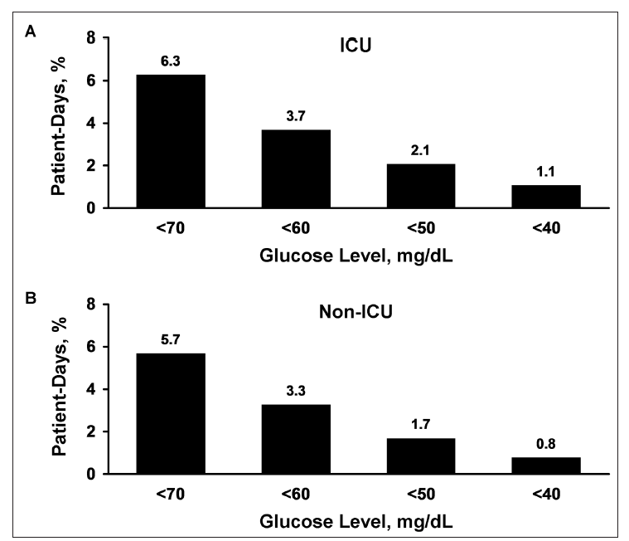
Prevalence of Hypoglycemia in Patients Receiving POC Glucose Testing
No. patients:
3,484,795
No. POC-BG:
49,191,313
ICU:
12,176,299
Non-ICU:
37,015,014
Swanson CM, et al. Endocr Pract. 2011;17:853-861.

Slide 59
Severe Hypoglycemia as an Independent Risk Factor for Mortality in the ICU
Condition | Severe Hypoglycemia | Mortality
Diabetes | 3.07* | 0.97
Septic shock | 2.03* | 1.33
Creatinine >3 mg/dL | 1.10 | 1.30*
Mechanical ventilation | 2.11* | 2.43*
Tight glycemia control | 1.59* | 0.67*
APACHE II score | 1.07* | 1.14*
Age | 1.01 | 1.03*
Severe hypoglycemia (≤40 mg/dL) | — | 2.28*
Krinsley JS, Grover A. Crit Care Med. 2007;35:2262-2267.
Notes:
59

Slide 60
Hypoglycemia and Hospital Mortality
Severe hypoglycemia (<40 mg/dL) is associated with an increased risk of mortality (OR, 2.28; 95% CI, 1.41-3.70; P=.0008)
Hypoglycemia was a predictor of higher mortality in patients not treated with insulin, but not in patients treated with insulin

Slide 61
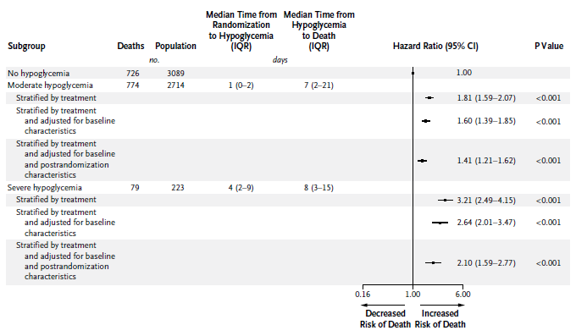
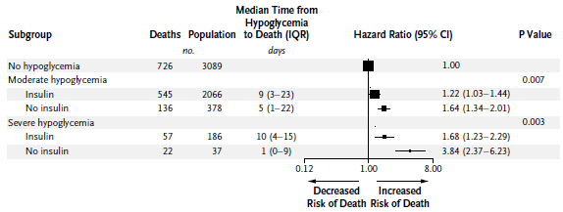
Hypoglycemia Mortality in Patients Receiving and Not Receiving Insulin
Risk of death with severe hypoglycemia vs no hypoglycemia
↑ 1.7-fold in patients receiving insulin
↑ 3.8-fold in patients not receiving insulin
NICE-SUGAR Study Investigators. N Engl J Med. 2012;367:1108-1118.

Slide 62
Blood Glucose During Hospitalization and Incidence of Death Within 2 Years
HR = 1.93
(1.18-3.17)
HR = 1.48
(1.09-1.99)
Risk of death within 2 years
HR = 0
(referent)
56-119 mg/dL
(3.1-6.5 mmol/L)
(n=364; 101 deaths)
≥120 mg/dL
(≥6.6 mmol/L)
(n=276; 107 deaths)
≤55 mg/dL
(≤3.0 mmol/L)
(n=44; 20 deaths)
Lowest blood glucose recorded during hospital stay
HR, hazard ratio.
Svensson AM, et al. Eur Heart J. 2005 26:1255-1261.

Slide 63
Hypoglycemia in Patients With Acute Coronary Syndrome
Unadjusted Results
 | Hypoglycemia | No hypoglycemia | P value
All patients | n=482 | n=7338
In-hospital mortality | 61 (12.7%) | 701 (9.6%) | 0.026
No insulin treatment | n=136 | n=4639
In-hospital mortality | 25 (18.4%) | 425 (9.2%) | 0.0003
Insulin-treated patients | n=346 | n=2699
In-hospital mortality | 36 (10.4%) | 276 (10.2%) | 0.92
Kosiborod M, et al. JAMA. 2009;301:1556-1564.

Slide 64
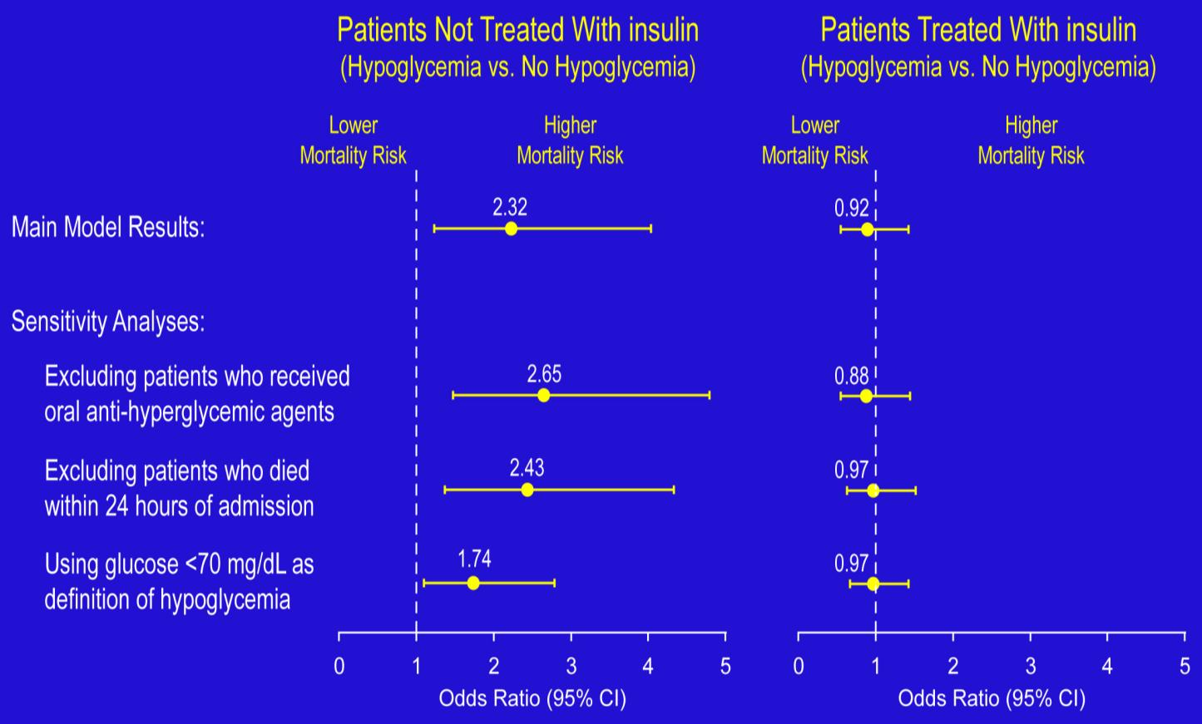
Hypoglycemia in Patients With Acute Coronary Syndrome: Multivariate Analysis
Kosiborod M, et al. JAMA. 2009;301:1556-1564.

Slide 65
Intensive Insulin Therapy and Hypoglycemic Events in Critically Ill Patients
No. Events/Total No. Patients |  |  |  | Hypoglycemic Events
Study | IIT | Control | Risk ratio (95% CI) | Favors IIT | Favors Control
Van den Berghe et al | 39/765 | 6/783 | 6.65 (2.83-15.62)
Henderson et al | 7/32 | 1/35 | 7.66 (1.00-58.86)
Bland et al | 1/5 | 1/5 | 1.00 (0.08-11.93)
Van den Berghe et al | 111/595 | 19/605 | 5.94 (3.70-9.54)
Mitchell et al | 5/35 | 0/35 | 11.00 (0.63-191.69)
Azevedo et al | 27/168 | 6/169 | 4.53 (1.92-10.68)
De La Rosa et al | 21/254 | 2/250 | 10.33 (2.45-43.61)
Devos et al | 54/550 | 15/551 | 3.61(2.06-6.31)
Oksanen et al | 7/39 | 1/51 | 9.15 (1.17-71.35)
Brunkhorst et al | 42/247 | 12/290 | 4.11(2.2-7.63)
Iapichino et al | 8/45 | 3/45 | 2.67 (0.76-9.41)
Arabi et al | 76/266 | 8/257 | 9.18 (4.52-18.63)
Mackenzie et al | 50/121 | 9/119 | 5.46 (2.82-10.60)
NICE-SUGAR | 206/3016 | 15/3014 | 13.72 (8.15-23.12)
Overall | 654/6138 | 98/6209 | 5.99 (4.47-8.03)
0.1
1
10
Risk Ratio (95% CI)
Griesdale DE, et al. CMAJ. 2009;180:821-827.

Slide 66
Hypoglycemia Is Associated With
Cardiovascular Complications
Tachycardia and high blood pressure
Myocardial ischemia
  Silent ischemia, angina, infarction
Cardiac arrhythmias
  Transiently prolonged corrected QT interval
  Increased QT dispersion
Sudden death
Wright RJ, Frier BM. Diabetes Metab Res Rev. 2008;24:353-363.

Slide 67
Current Recommendations

Slide 68
Guidelines From Professional Organizations on the Management of Glucose Levels in the ICU
Year | Organization | Patient Population | Treatment Threshold | Target Glucose Level | Definition of Hypoglycemia | Updated since NICE-SUGAR Trial, 2009
2009 | American Association of Clinical Endocrinologists and American Diabetes Association | ICU patients | 180 | 140-180 | <70 | Yes
2009 | Surviving Sepsis Campaign | ICU patients | 180 | 150 | Not stated | Yes
2009 | Institute for Healthcare Improvement | ICU patients | 180 | <180 | <40 | Yes
2008 | American Heart Association | ICU patients with acute coronary syndromes | 180 | 90-140 | Not stated | No
2007 | European Society of Cardiology and European Association for the Study of Diabetes | ICU patients with cardiac disorders | Not stated | “Strict” | Not stated | No
Kavanagh BP, McCowen KC. N Engl J Med. 2010;363:2540-2546.

Slide 69
Guidelines From Professional Organizations on the Management of Glucose Levels in Noncritically Ill Patients
Year | Organization | Patient Population | Treatment Threshold | Target | Definition of Hypoglycemia | Updated since NICE-SUGAR Trial, 2009
2009 | AACE and ADA Consensus Statement | Non-critically ill patients | 180 mg/dL | Premeal <140 mg/dL | <70 mg/dL (reassess treatment if <100 mg/dL) | Yes
2012 | Endocrine Society Clinical Practice Guideline | Non-critically ill patients | 180 mg/dL | Premeal <140 mg/dL | (reassess treatment if <100 mg/dL) | Yes
Moghissi ES, et al. Endocr Pract. 2009;15:353-369.
Umpierrez GE, et al. J Clin Endocrinol Metabol. 2012;97:16-38.

Slide 70
AACE/ADA Recommended Target Glucose Levels in ICU Patients
ICU setting:
  Starting threshold no higher than 180 mg/dL
  Once IV insulin is started, the glucose level should be maintained between 140 and 180 mg/dL
  Lower glucose targets (110-140 mg/dL) may be appropriate in selected patients
  Targets <110 mg/dL or >180 mg/dL are not recommended
Not recommended
<110
Acceptable
110-140
Recommended
140-180
Not recommended
>180
Moghissi ES, et al. Endocr Pract. 2009;15:353-369.

Slide 71
AACE/ADA Recommended Target Glucose Levels in Non-ICU Patients
Non–ICU setting:
  Premeal glucose targets <140 mg/dL
  Random BG <180 mg/dL
  To avoid hypoglycemia, reassess insulin regimen if
  BG levels fall below 100 mg/dL
  Occasional patients may be maintained with a glucose range below and/or above these cut-points
Hypoglycemia = BG <70 mg/dL
Severe hypoglycemia = BG <40 mg/dL
Moghissi ES, et al. Endocr Pract. 2009;15:353-369.

Slide 72
Endocrine Society Recommended Target Glucose Levels in Non-ICU Patients
Blood glucose targets for the majority of patients
  Premeal: <140 mg/dL
  Random: <180 mg/dL
Glycemic targets should be modified according to clinical status
  For patients who achieve and maintain glycemic control without hypoglycemia, a lower target range may be reasonable
  For patients with terminal illness and/or with limited life expectancy or at high risk for hypoglycemia, a higher target range (BG <200 mg/dl) may be reasonable
To avoid hypoglycemia, reassess and modify diabetes therapy when BG is ≤100 mg/dL
Modification of glucose-lowering treatment is usually necessary when BG values are <70 mg/dL
Umpierrez GE, et al. J Clin Endocrinol Metabol. 2012;97:16-38.

